Slide 1
High Energy Physics and Grid
Oxana Smirnova
FYS225/FKF050
February 27, 2007, Lund

Slide 2
High Energy Physics: quick intro
High Energy Physics studies elementary particles and forces that constitute the matter
  Also known as Particle Physics
  Is the most fundamental of all the physical sciences
  The ultimate goal: to understand the origin of the Universe
  We’ve learned a lot over the past years, yet more is unknown

Slide 3
Standard Model of forces and particles
Leptons
Strong
Electromagnetic
Electric Charge
Gluons (8)
Photon
Tau
-1
0
Tau
Neutrino
Muon
-1
0
Muon
Neutrino
Quarks
Atoms
Electron
-1
0
Electron
Light
Neutrino
Mesons
Chemistry
Baryons
Nuclei
Electronics
Quarks
Gravitational
Weak
Electric Charge
Bosons
Graviton ?
Bottom
-1/3
2/3
Top
(W,Z)
Strange
-1/3
2/3
Charm
Down
Up
Solar system
Neutron decay
-1/3
2/3
Galaxies
Beta radioactivity
Black holes
Neutrino interactions
each quark:
R
,
B
,
G
3 colours
Burning of the sun
The particle drawings are simple artistic representations

Slide 4
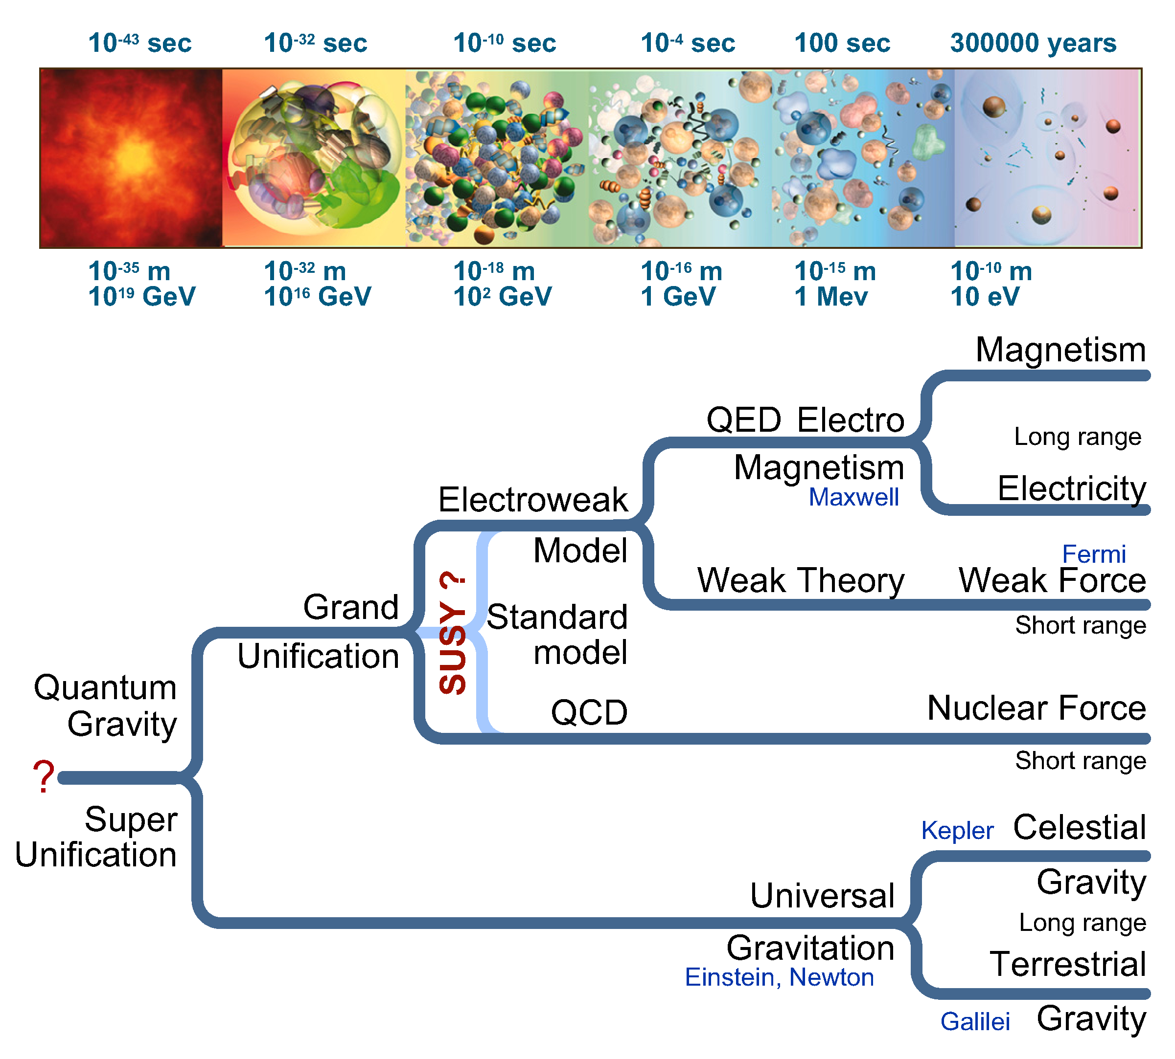
From Big Bang to now: the theory

Slide 5
Still, we know too little about ourselves!
Can gravity be included in a theory with the other three interactions?
Why do the particles have the masses we observe, and what is the origin of mass?
How many space-time dimensions do we live in?
Are the known elementary particles fundamental or do they possess structure?
Why is the electrical charge on the electron equal and opposite to that on the proton?
Why are there three generations of quarks and leptons?
Why is there overwhelmingly more matter than anti-matter in the Universe?
Are protons unstable?
What is the nature of the dark matter that pervades our Galaxy?
Are there new states of matter at exceedingly high density and temperature?
Do the neutrinos have mass, and if so why are they so light?

Slide 6

Large Hadron Collider:
World’s biggest accelerator at CERN
Will start operating in fall 2007

Slide 7
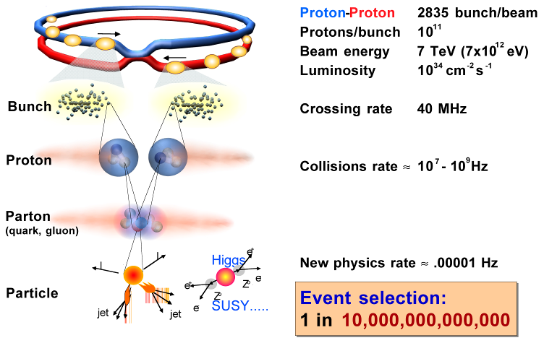
Collisions at LHC
Will help to solve:
The mass problem – discover Higgs particle?
The Dark Matter of the Universe – discover supersymmetric particles?
Matter vs Antimatter – CP violation?

Slide 8
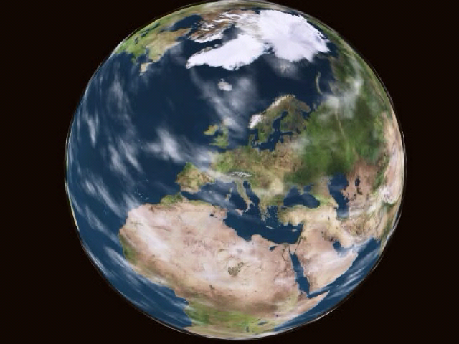
ATLAS detector at LHC

Slide 9



“Full chain” of HEP data processing
Event generation (Pythia)
Detector simulation (Geant4)
Hit digitization
100011110101110101100101110110100
Reconstruction
Analysis data preparation
Analysis, results (ROOT)
Slide adapted from Ch.Collins-Tooth and J.R.Catmore

Slide 10
Monte Carlo data production flow (10 Mevents)
Very different tasks/algorithms (ATLAS experiment in this example)
Single job lasts from 10 minutes to 20 hours
Most tasks require large amounts of input and produce large output data

Slide 11
Software for HEP experiments
Massive pieces of software
  Written by very many different authors in different languages (C++, Java, Python, Fortran)
  Dozens of external components
  Occupy as much as ~10 GB of disk space each release
Frequent releases
  Every experiment can release as often as once a month during the preparation phase (which is now for LHC)
Difficult to set up outside the lab
  Experiments can not afford supporting different operating systems and different computer configurations
For a small university group it is very difficult to manage different software sets and maintain hardware
  ALICE, ATLAS, H1, PHENIX etc – all in many versions
  Solution: use external computing resources

Slide 12
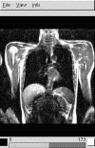
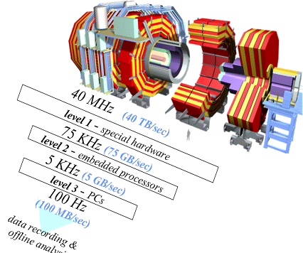
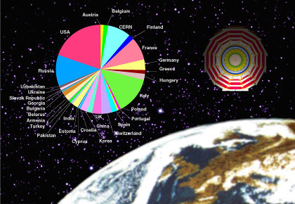
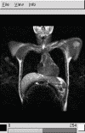
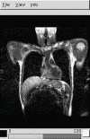
HEP computing specifics
Data-intensive tasks
  Large datasets, large files
  Lengthy processing times
  Large memory consumption
  High throughput is necessary
Very distributed resources
  Distributed computing resources of modest size
  Produced and processed data are hence distributed, too
  Issues of coordination, synchronization and authorization are outstanding
HEP is by no means unique in its demands, but we are first, we are many, and we badly need it

Slide 13
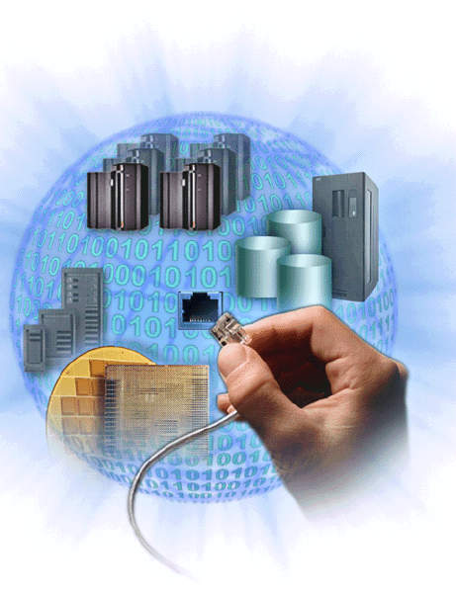
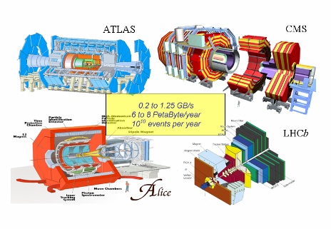
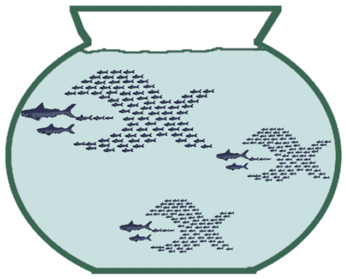
Grid to the rescue
Distributed supercomputer, based on commodity PCs and fast WAN
Access to the great variety of resources by a single pass – certificate
A possibility to manage distributed data in a synchronous manner
A new commodity
Sewage
The Grid
Supercomputer
Water
Electricity
Radio/TV
Internet
PC Farm
Workstation
Grid

Slide 14









From distributed resources …
Present situation:
cross-national projects
users and resources in different domains
separate access to each resource

Slide 15
… to World Wide Grid
Future:
multinational projects
resources location is irrelevant
“plug-n-play” access to all the resources

Slide 16
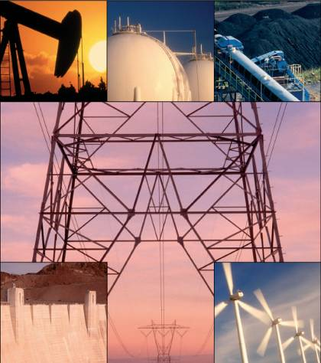
Origin of the word “Grid”
Coined by Ian Foster and Carl Kesselman around 1997
Refers to computing grids as analogy of power grids
  Many producers
  Competing providers
  Simple for end-users
Spelled “grid” or “Grid”
  Except in French: “Grille de calcul”

Slide 17
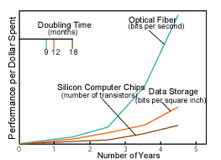
Grid as a result of IT progress
Network vs. computer performance:
  Computer speed doubles every 18 months
  Network speed doubles every 9 months
1986 to 2000:
  Computers: 500 times faster
  Networks: 340000 times faster
2001 to 2010 (projected):
  Computers: 60 times faster
  Networks: 4000 times faster
Bottom line: CPUs are fast enough; wide area networks are very fast – gotta make use of it!
Slide adapted from the Globus Alliance

Slide 18
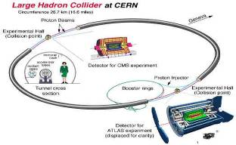
How did Grid appear in Lund
Back in 2001, High Energy Physics Institutes from Scandinavia wanted to share their computing resources and jointly contribute to CERN/LHC computing
  We needed Grid
  The Grid hype just begun…
  … and we created a NorduGrid
  project (Lund, Uppsala, Copenhagen,
  Oslo, Helsinki and many others)
No production ready grid software
(middleware) was available or seen
on the horizon in fall 2001
In February 2002, NorduGrid boldly
decided to develop own Grid
middleware
  Was baptized ARC, for Advanced Resource Connector
  Since May 2002 ARC is extensively used in ATLAS production and other scientific computing projects

Slide 19
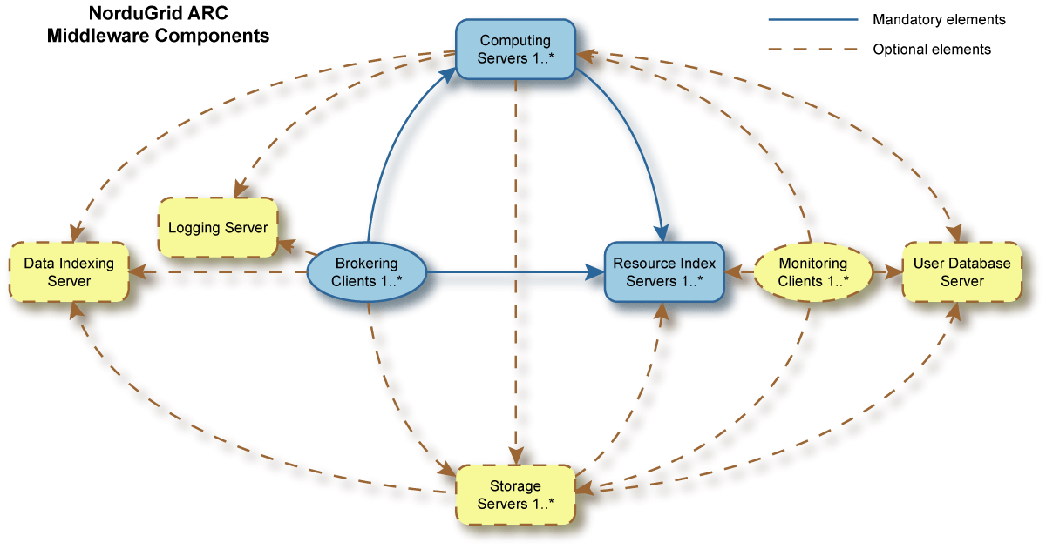
ARC in a nutshell
Goal: no single point of failure

Slide 20












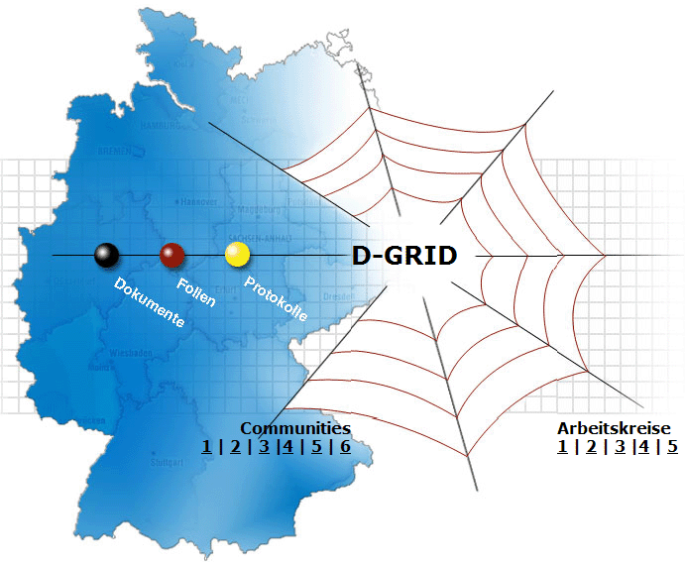
















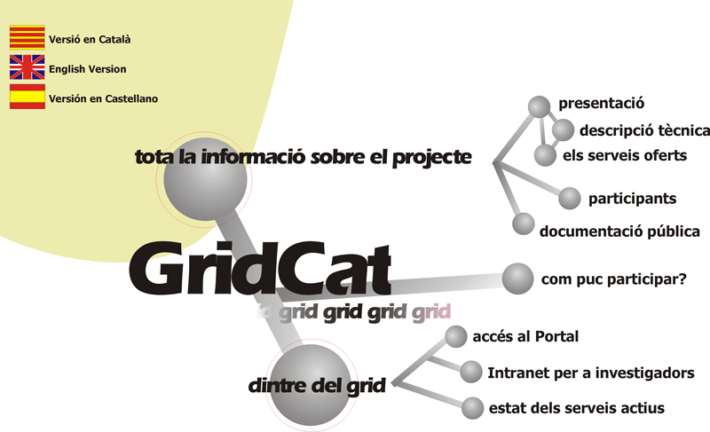



ARC is not the only one…
Slide adapted from Vicky White, FNAL

Slide 21



Grids in ATLAS
All ATLAS production today is done via Grid
There are 20+ Grid flavors out there
  Almost all are incompatible with each other
  Almost all are tailored for a specific application and/or specific hardware
ATLAS makes use of only 3 Grid flavors:
  gLite – formerly known as LCG
  ARC – formerly known as NorduGrid
  OSG – formerly known as Grid3
  They are still incompatible with each other
    A lot of interoperability efforts take place

Slide 22
ARC and ATLAS
Via NorduGrid/ARC, Nordic countries contribute to ATLAS Data Challenges since 2002
  Resources donated to ATLAS by national Grid projects, enthusiastic owners
    Highly heterogeneous (OS: Fedora Core N, Red Hat, Debian, Gentoo,...; LRMS: PBS/Torque, Condor, SGE…)
    No common policies enforced
    Loosely coupled
  Currently, ca 10% of ATLAS production tasks
    Only 2 persons in charge of the production
    Highest resource usage efficiency, reliability
  Accumulated ~40TB of ATLAS data in ~50 locations
    Includes e.g. Ljubljana – still, indistinguishable for jobs and outside users

Slide 23
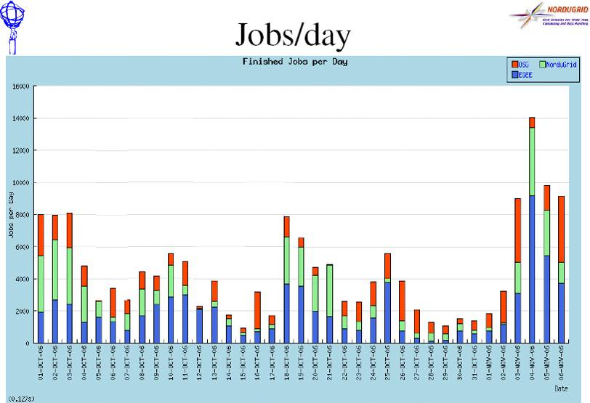
ATLAS Monte Carlo production with NorduGrid/ARC

Slide 24
Next step: Nordic Tier1
WLCG: Worldwide LHC Computing Grid
  A CERN project aiming to provide HEP computing infrastructure
  Tiered structure: Tier0 at CERN, a dozen of regional Tier1s, many local Tier2s etc
WLCG Tier1 is primarily a set of services:
  24/7 on-call support system
  Infrastructure: network, power, cooling, safety etc
  Authorization, specific software for entire multinational VOs
  Job submission interface
  Data indexing service
  Storage resource management interface
  File transfer services between Tiers
  Experiment-specific interfaces (“VOBoxes”)
  Database service (ORACLE)
  Other: information system, monitoring, logging etc
Resource commitments (processing power, storage, bandwidth) are expressed in WLCG MoU

Slide 25
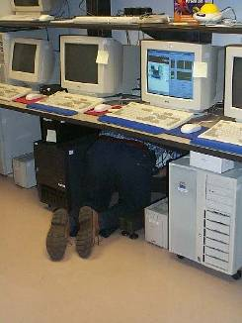
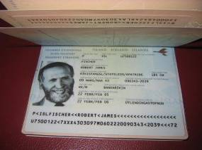
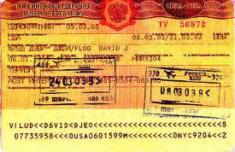
Where do I start on my way to Grid?
Ask local sysadmin to install a Grid client
  NorduGrid standalone client is the easiest: you can install it yourself
Apply for a “passport”: the Grid certificate (grid-cert-request)
  NorduGrid Certification Authority is appropriate for SU employees
Ask a knowledgeable person which Grid is adopted by your collaboration/group
Apply for a “visa”: become an appropriate Virtual Organization (VO) member
Read the manual
Rule of thumb: do not keep your credentials on a public computer. USB memory key is a good choice.

Slide 26
Conclusion
High Energy Physics is the major consumer of Grid technologies
  Every HEP researcher sooner or later will have to learn grid basics
  HEP community invests massive efforts into grid development
  If grid won’t help, it is unclear what would be the “backup solution”
    The data will eventually be processed, the question is – how soon and how accurate
Many other sciences are on-looking
  Bioinformatics and radioastronomy appear to be the next in line
    Huge data volumes, trivially parallel processing, distributed user base
See you in the Grid-space!

