Slide 1
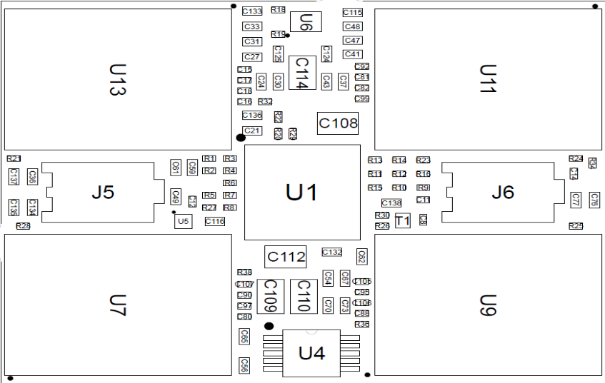

Slide 2
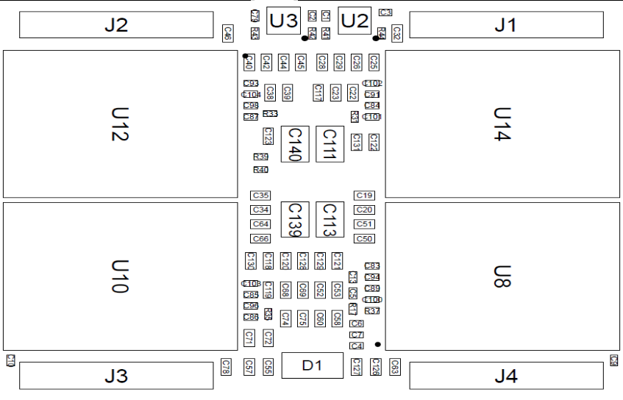
24
2
21
MCM
1
4
1
15

Slide 3
v
v
v
in
v
ut

