Slide 1

The highest man-made temperature
In February 2010, scientists at Brookhaven National Laboratory's Relativistic Heavy Ion Collider on Long Island, New York, USA, announced that they had smashed together gold ions at nearly the speed of light, briefly forming an exotic state of matter known as a quark-gluon plasma. This substance is believed to have filled the universe just a few microseconds after the Big Bang. During the experiment the plasma reached temperatures of around 4 trillionºC, some 250,000 times hotter than the centre of the Sun.

Slide 2

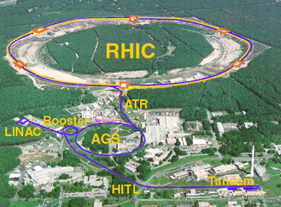
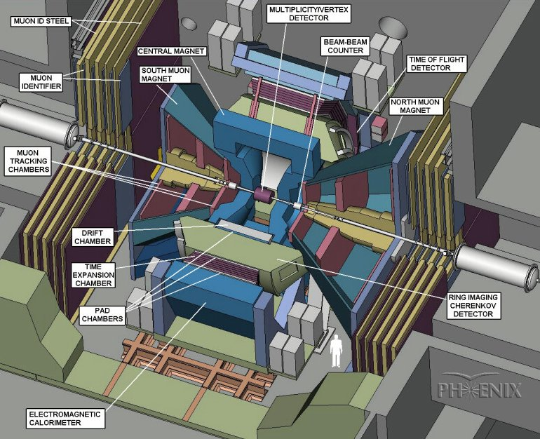
Brookhaven National Laboratory's Relativistic Heavy Ion Collider
Lund – 10MSEK worth design, development and construction to the Pad Chambers
RHIC is the first heavy ion collider in the world. Operational since 2000 (program until 2020+). Max beam energy: √s_{NN}=200GeV

Slide 3
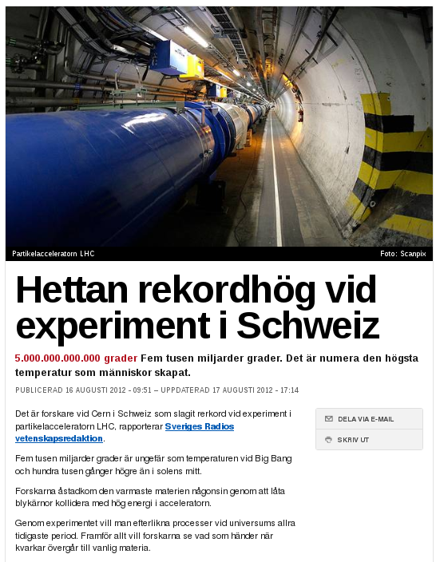
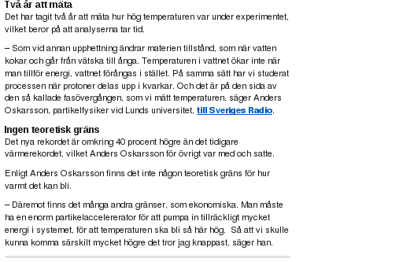

Record broken at LHC
http://www.svt.se/nyheter/vetenskap/hettan-rekordhog-vid-experiment-i-schweiz

Slide 4
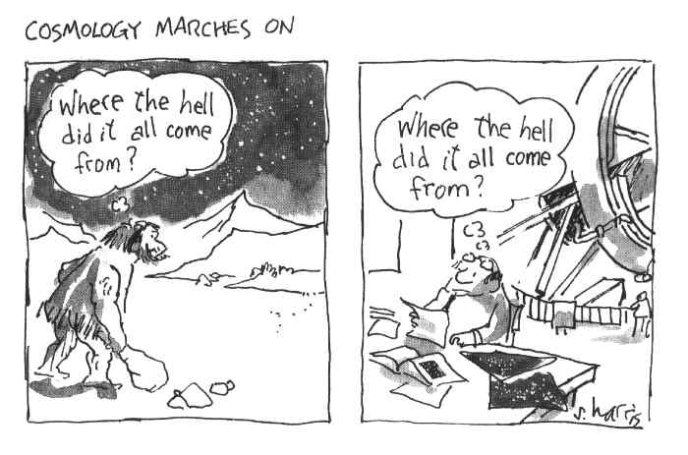
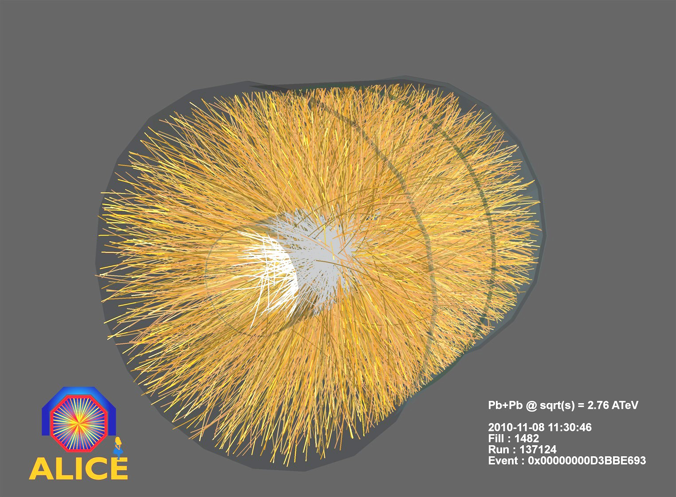
The highest man-made temperature
QCD and hadron collisions
  Soft and hard physics
The medium created in heavy ion collisions
  A nearly perfect liquid
How we measure temperature
1 small bang in the
ALICE experiment

Slide 5
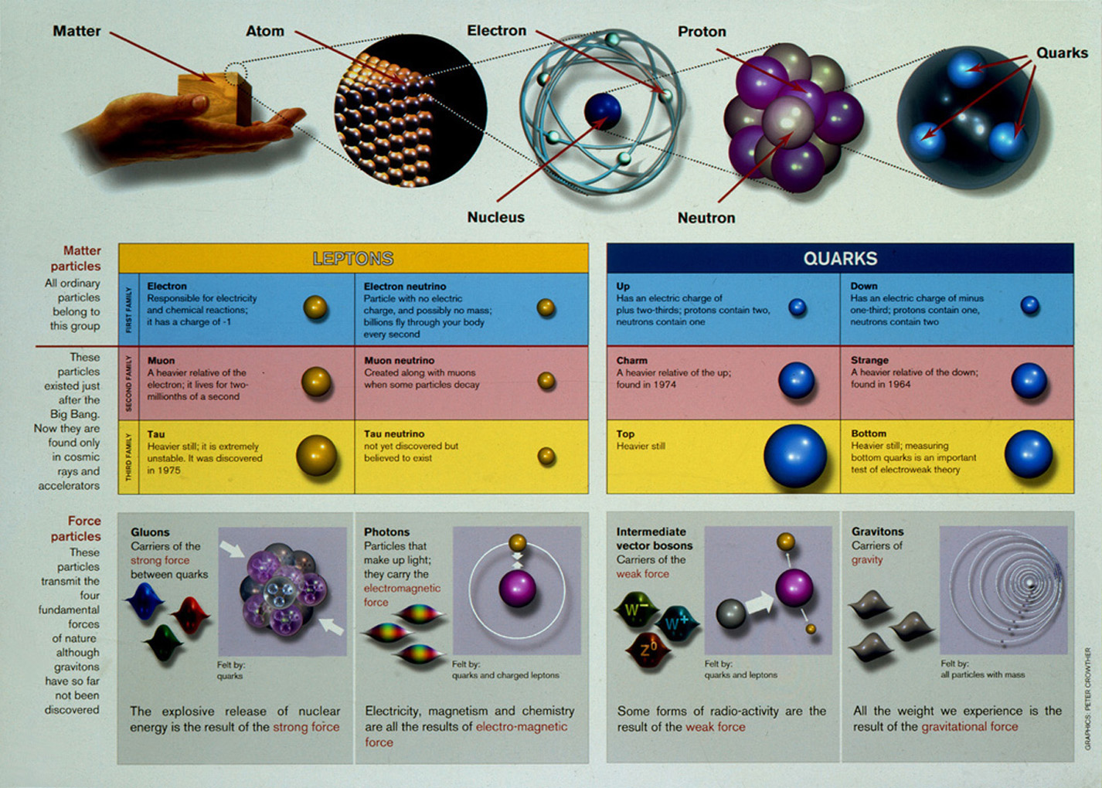

Slide 6
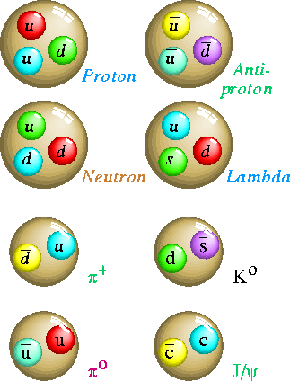
Quantum Chromo Dynamics (QCD)
3 color charges (red, green, blue)
Hadrons have to be colorless
Baryons have all 3 colors
Mesons has a color and an anti-color
A single quark cannot be observed because it has color!
The quarks are confined inside the hadrons!
Hadrons
Baryons
Mesons

Slide 7
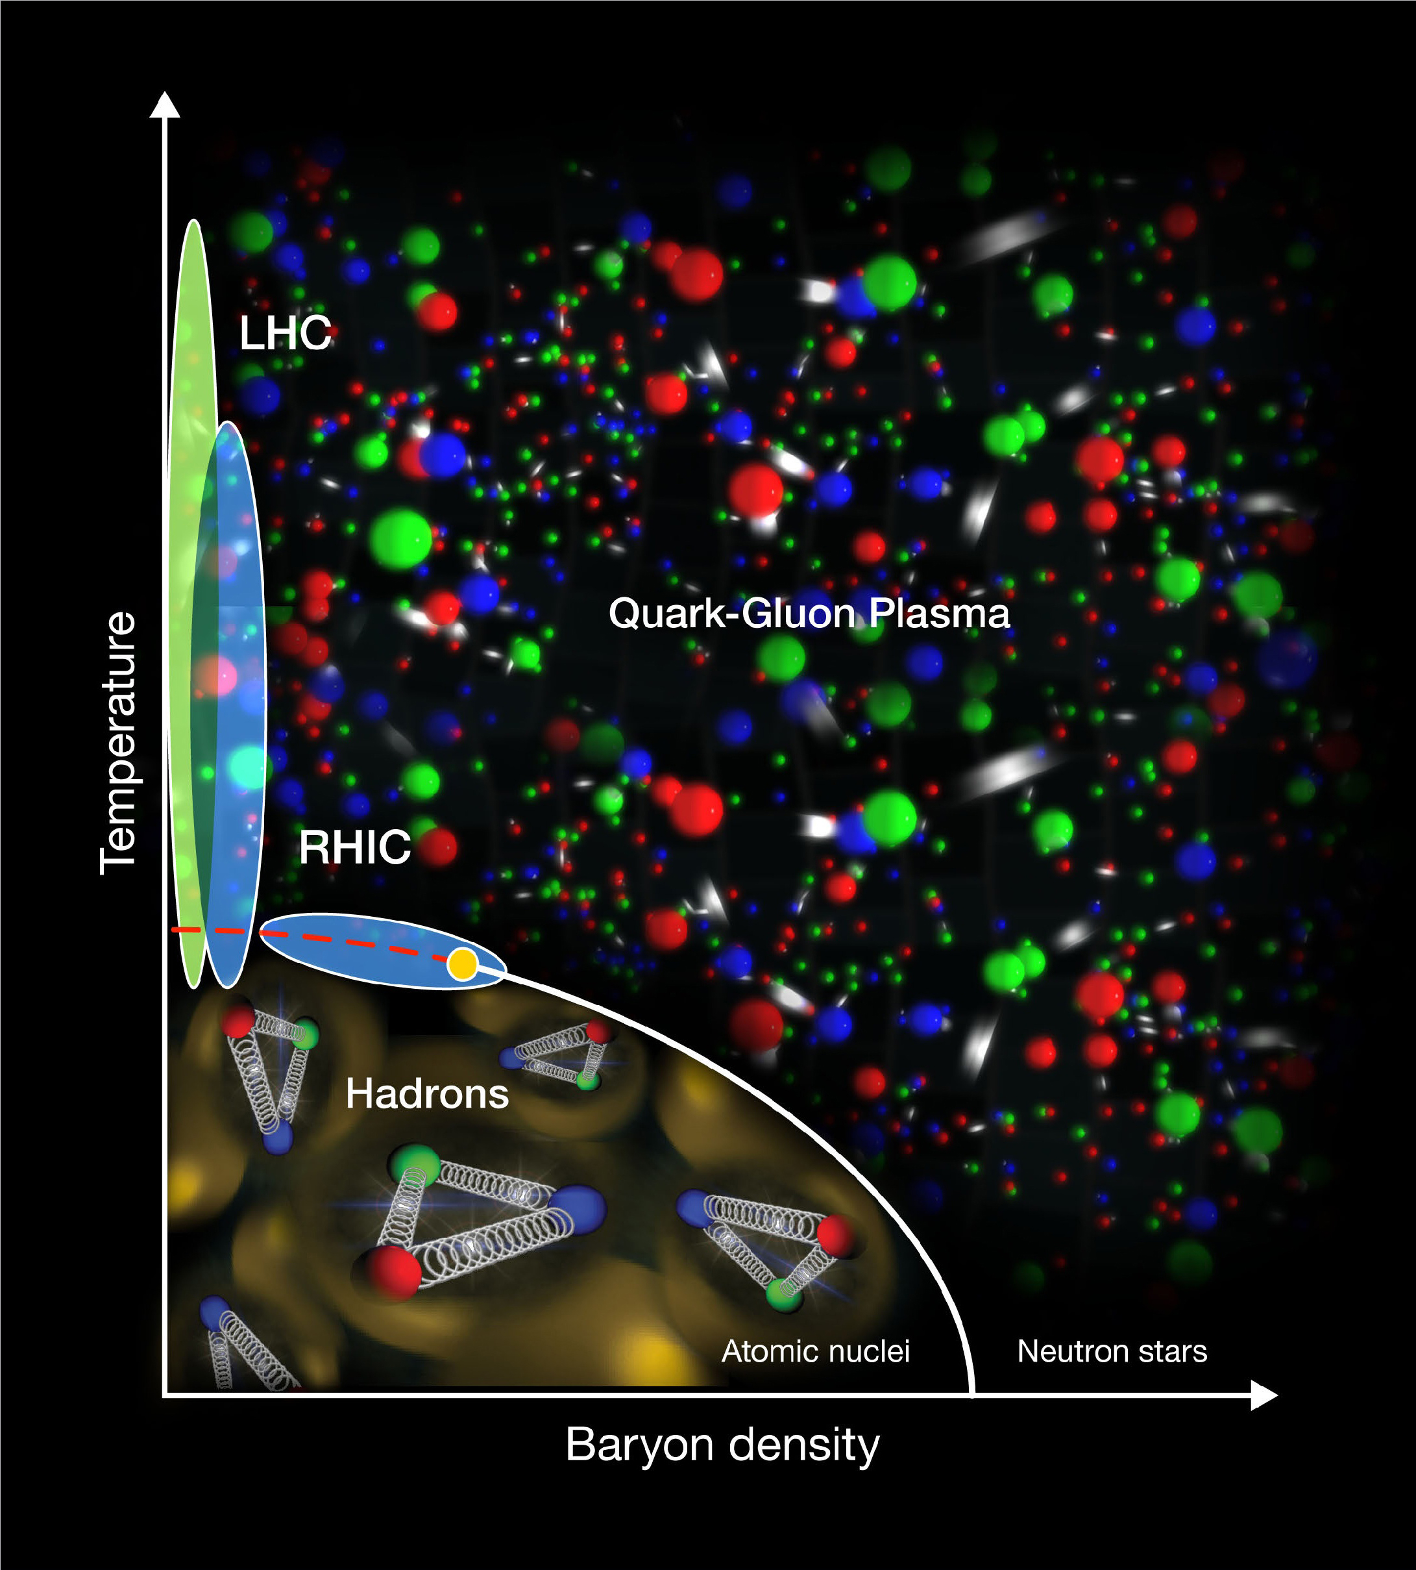
QCD phase diagram
Hadronic matter phase (quarks and gluons are confined)

Slide 8
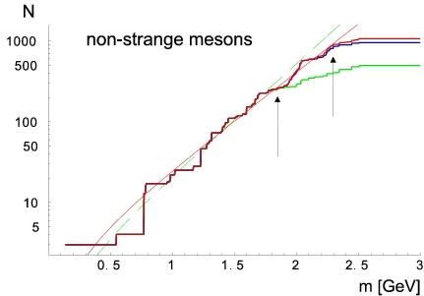
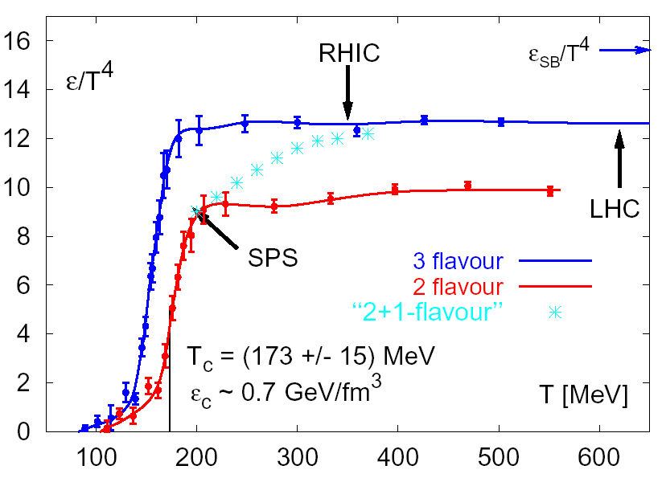






What happens at higher energy densities?
Accumulated hadronic states
(Hagedorn)
QCD energy denisty
(Lattice QCD)
(F. Karsch, hep-lat/0106019)
Mass
In a statistical model the hadronic states are populated proportional to: exp(-m/T)
Critical (Hagedorn) temperature
~ 200-300 MeV.
$$ε_{QCD}=\frac{π^{2}}{30}\left.(2×8+\frac{7}{8}2×2×3×3)\right.T^{4}$$
Gluon spin and color
(Anti+)quark spin, color and flavor

Slide 9
QCD phase diagram
T~170MeV
1 eV = 11605K
T~2,000,000,000,000K
(T core sun:
16,000,000K)
By colliding heavy ions we hope to create (and study the characteristics of) a new phase of matter called the Quark Gluon Plasma (where quarks and gluons are deconfined)

Slide 10
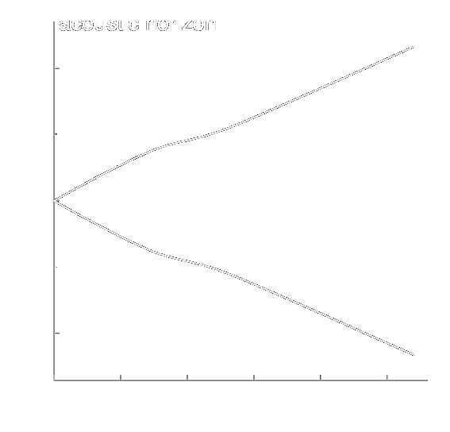
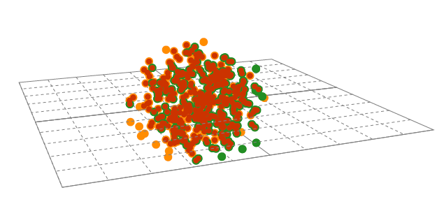


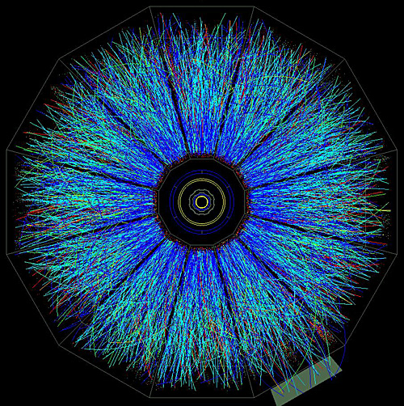
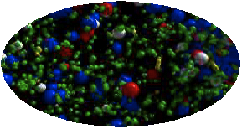
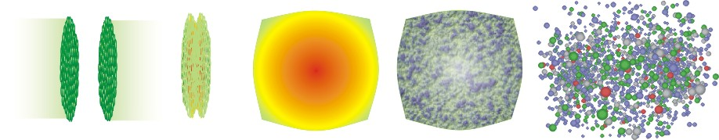
QGP in the laboratory
distributions & correlations of produced particles
kinetic
freeze-out
QGP Phase Boundary
lumpy initial energy density
QGP phase
quark and gluon degrees of freedom

Slide 11

The LHC accelerator at CERN

Slide 12
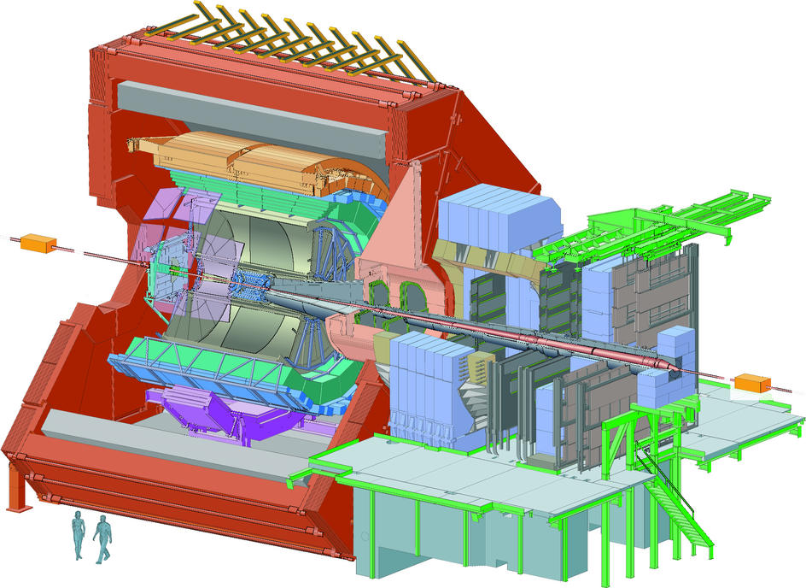
The ALICE experiment at LHC
The ALICE
Time Projection
Chamber (TPC)

Slide 13
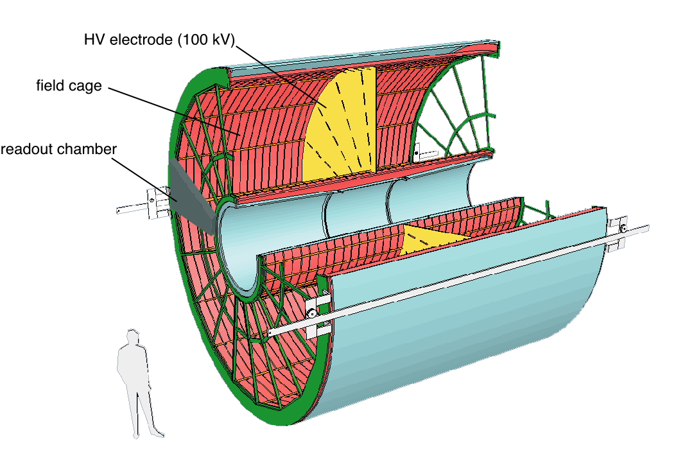
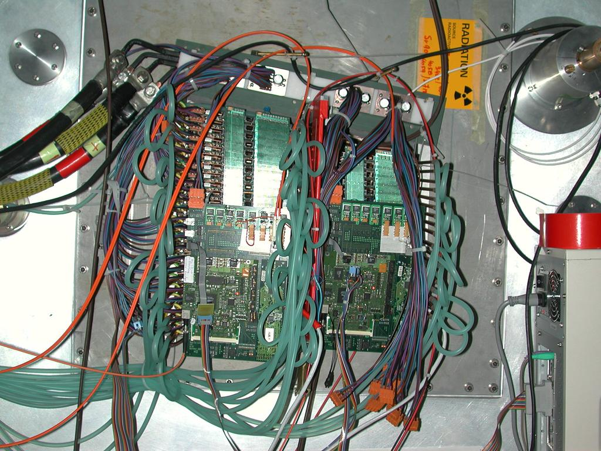
The ALICE TPC
Large data volume:
570 132 (pads) x 1000 (time bins)
~700 MB/event (NO 0-suppression!)
Pb – Pb ➔ ~20 MB/event (after 0-)
p-p ➔ < 1MB/event (suppres.)
510 cm
E
E
88µs
Lund – 20MSEK worth development and construction to the TPC electronics
GEM upgrade for 2019 approved by LHCC
560 cm
Gas volume:
95 m³
Drift gas:
Ne-CO₂ –N₂ (86-9-5)
Notes:
13

Slide 14
One collision in the ALICE TPC
ALICE first PbPb collisions: 8/11-2010
Factor 14 jump in energy!

Slide 15
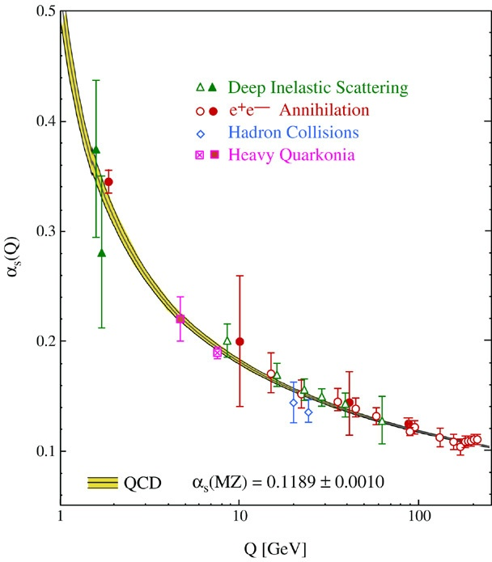
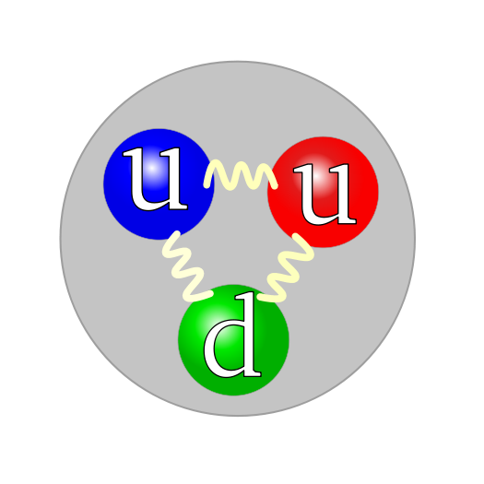
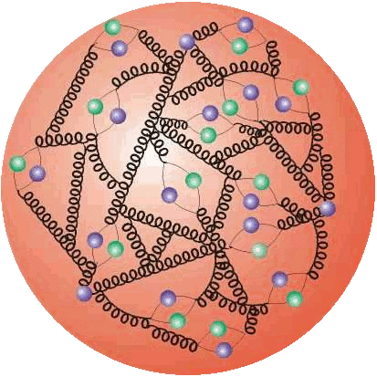
What happens when we collide pp and Pb-Pb
SOFT
HARD
Non-perturbative physics
(know the equations but not how to
solve them)
Bulk properties (=medium)
Perturbative physics
(theoretical predictions)
Rare processes
jets (=probes)
2 answers!

Slide 16
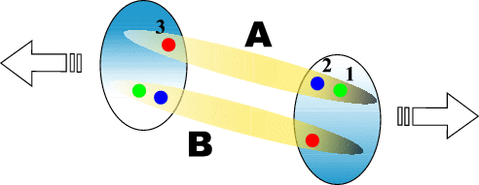
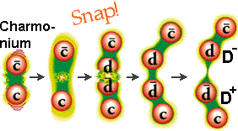
Phenomenological model of soft physics e.g. Lund string model
q₁
q₂
a) QED or QCD (r < 1 fm)
r
q₁
q₂
b) QCD (r > 1 fm) – constant string-like force ~ 1GeV/fm

Slide 17

What is 1 GeV/fm for a macroscopic force?
10t

Slide 18
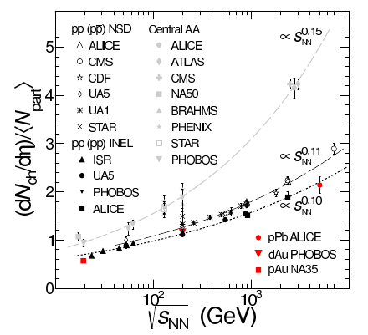
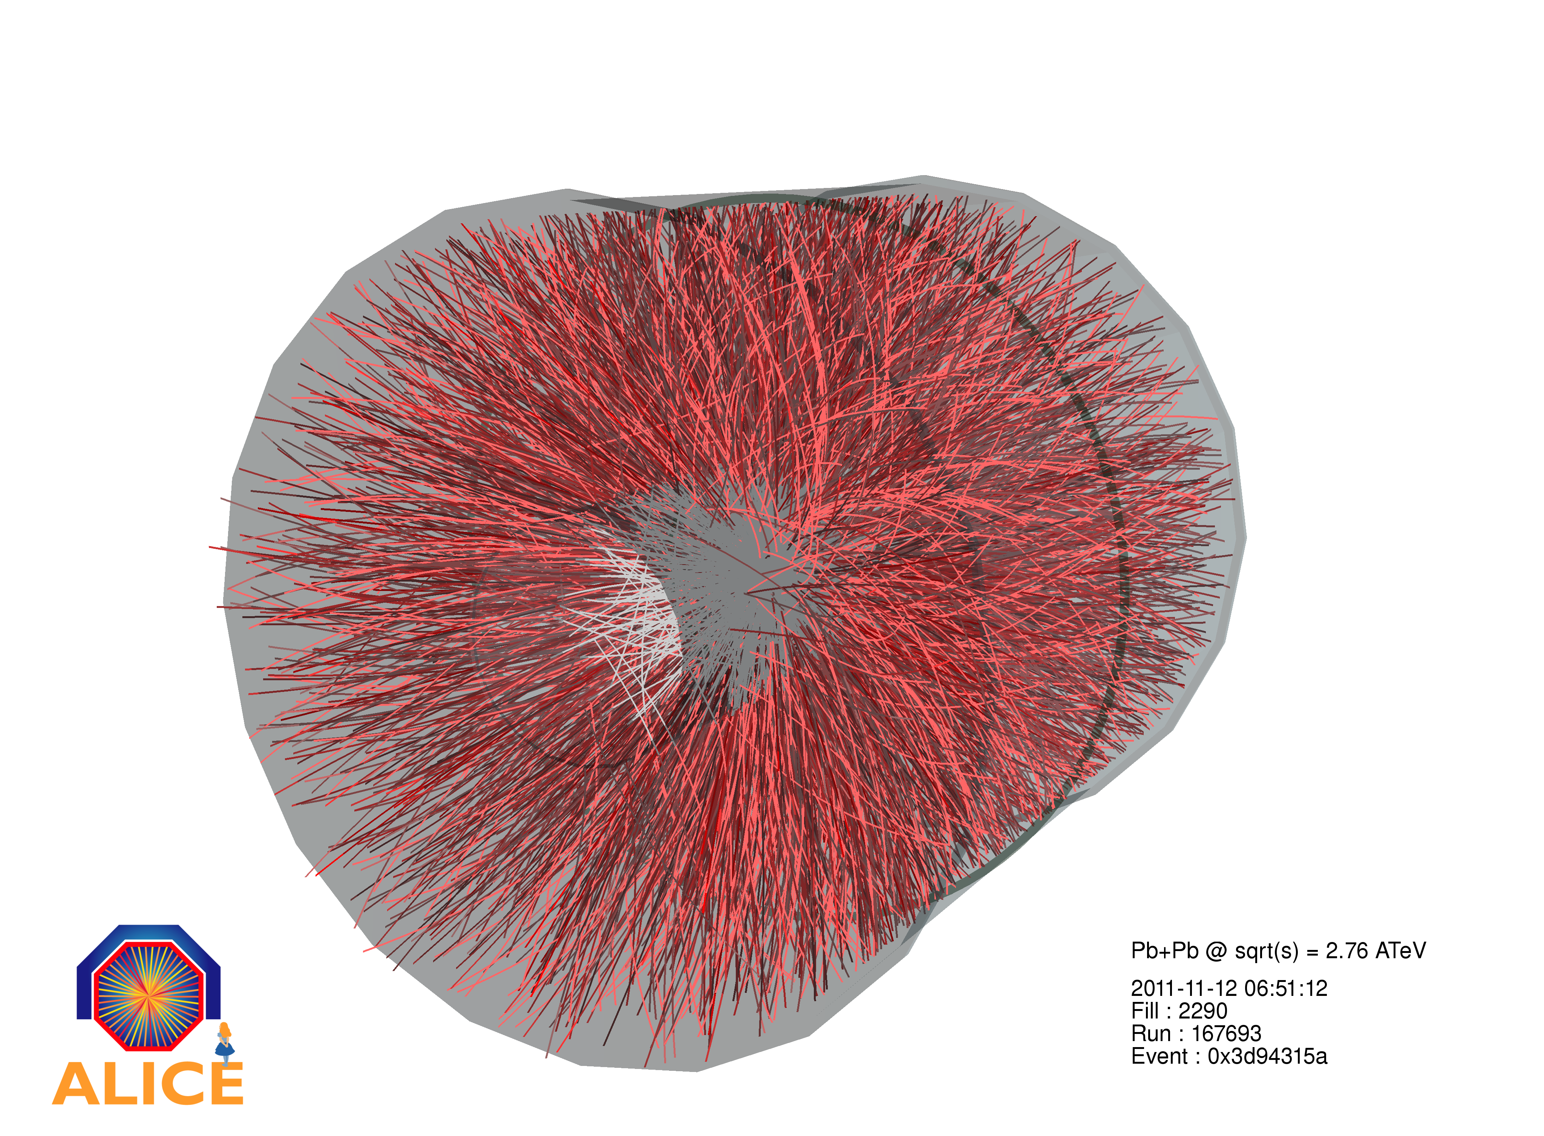
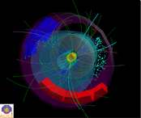
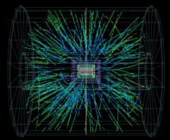
Bulk observables – multiplicity dN/dη at 90º per nucleon
ALICE Collaboration:
Submitted to PRL.
http://arxiv.org/abs/1210.3615
Total integrated number of charged particles: ~17,000 for most central 0-5% collisions

Slide 19
Jets in pp
hadrons from jet fragmentation
parton
parton
hadrons from jet fragmentation

Slide 20
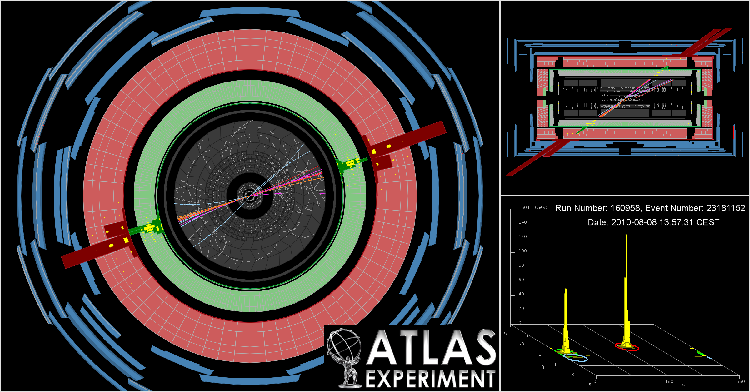
Jets in pp

Slide 21
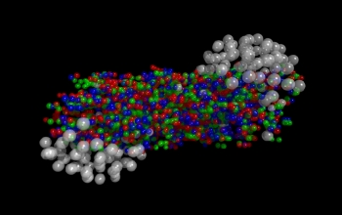
Jets in Pb-Pb
hadrons from leading jet
parton
parton
hadrons from quenched jet

Slide 22
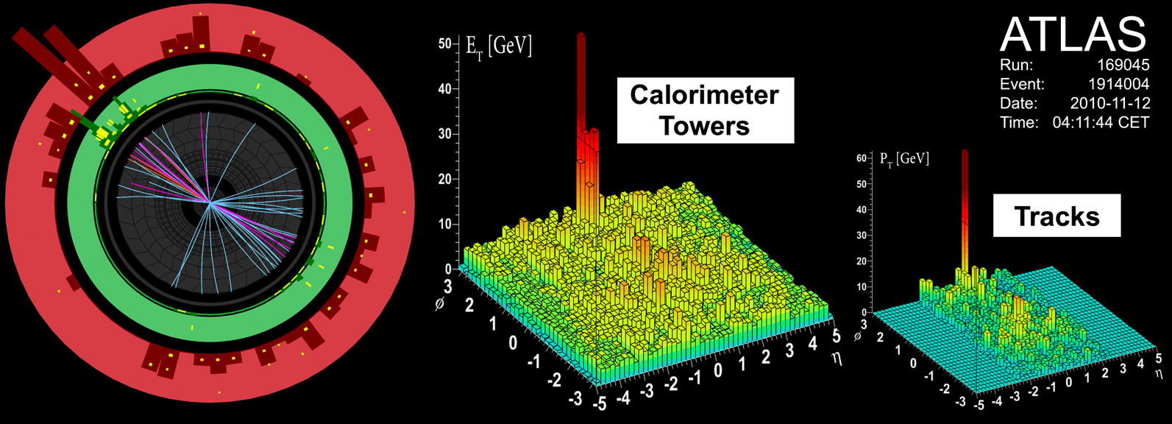
Jets in Pb-Pb
Jet asymmetry – away side jet is absorbed/modified by the medium

Slide 23
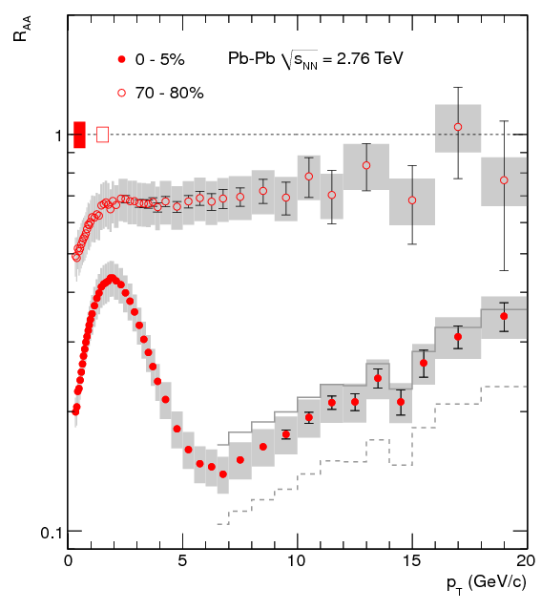
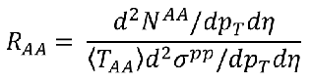
The nuclear modification factor R_{AA} for unidentified hadrons
<T_{AA}>σ^{pp}=<N_{coll}>
N_{coll} is the number of binary collisions
R_{AA}<1: suppresion
R_{AA}=1: no nuclear effects
R_{AA}>1: enhancement
Jet quenching on the track level
  65-85% less high p_{T} tracks than expected from binary scaling

Slide 24
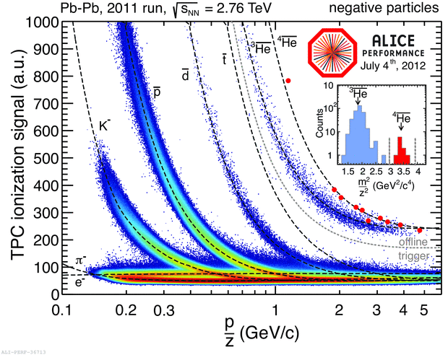
R_{AA} for identified charged hadrons
Use the additional information for each track encoded in the TPC dE/dx (“Bethe-Bloch”)

Slide 25
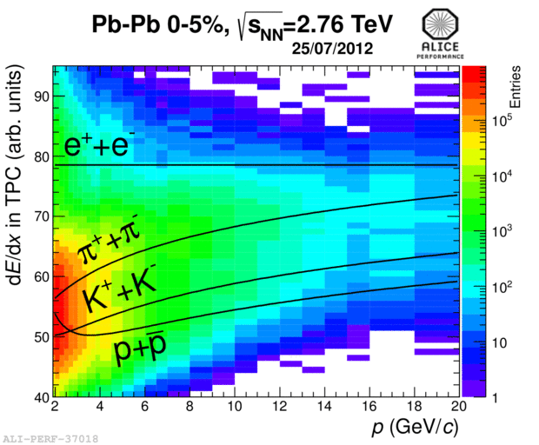
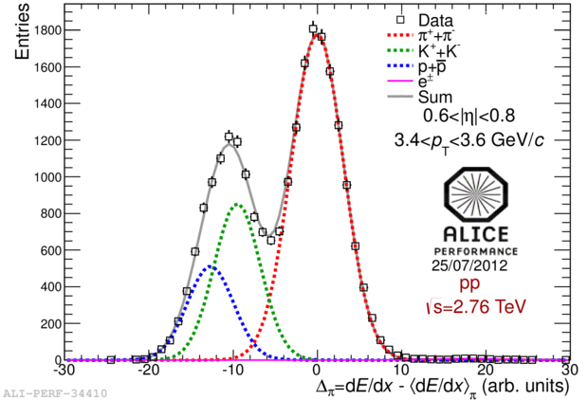
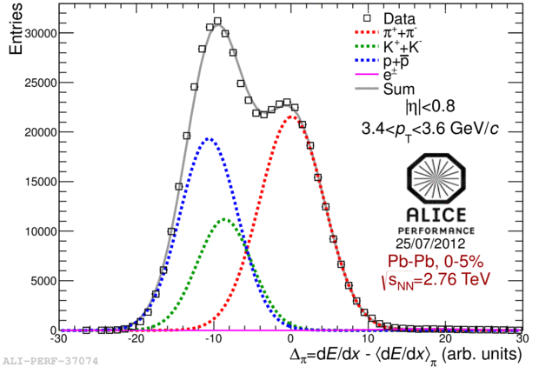
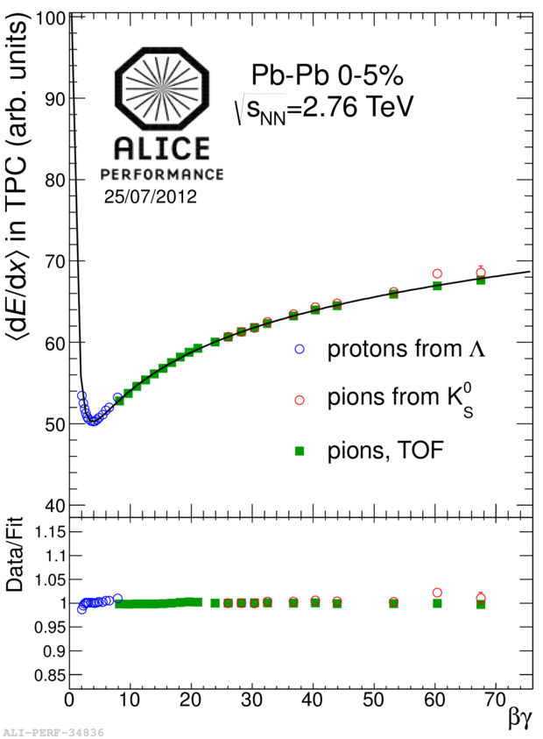
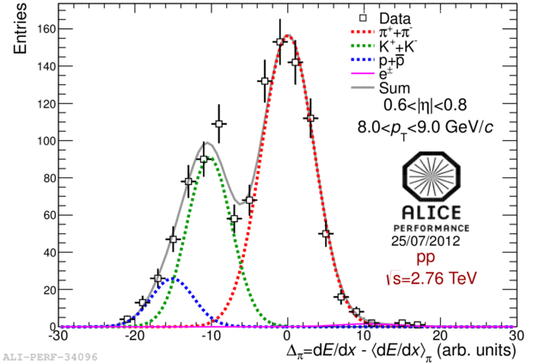
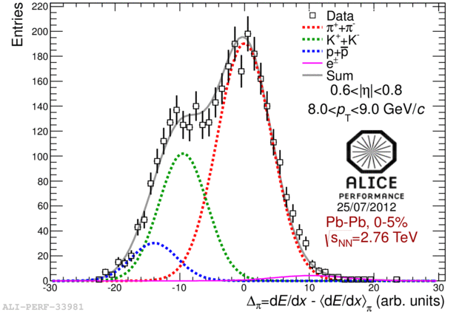
R_{AA} for identified charged hadrons (Lund)
Pushing the separation to the relativistic rise
pp central PbPb
Pions
Kaons
Protons
Baryon anomaly in central PbPb.
Quark recombination?
p_{T} →
Baryon anomaly not observed at high p_{T} as
speculated pre-LHC.

Slide 26
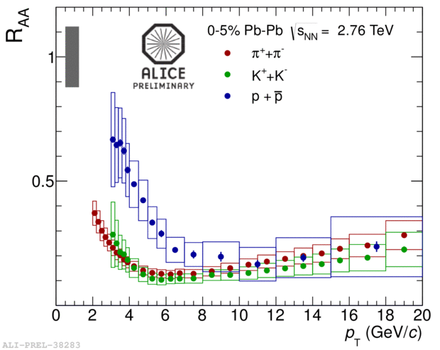
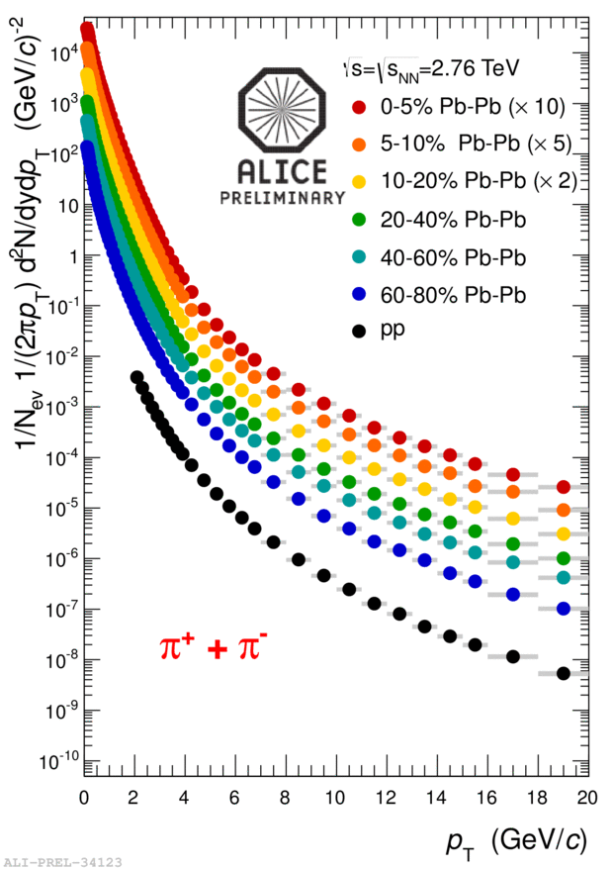
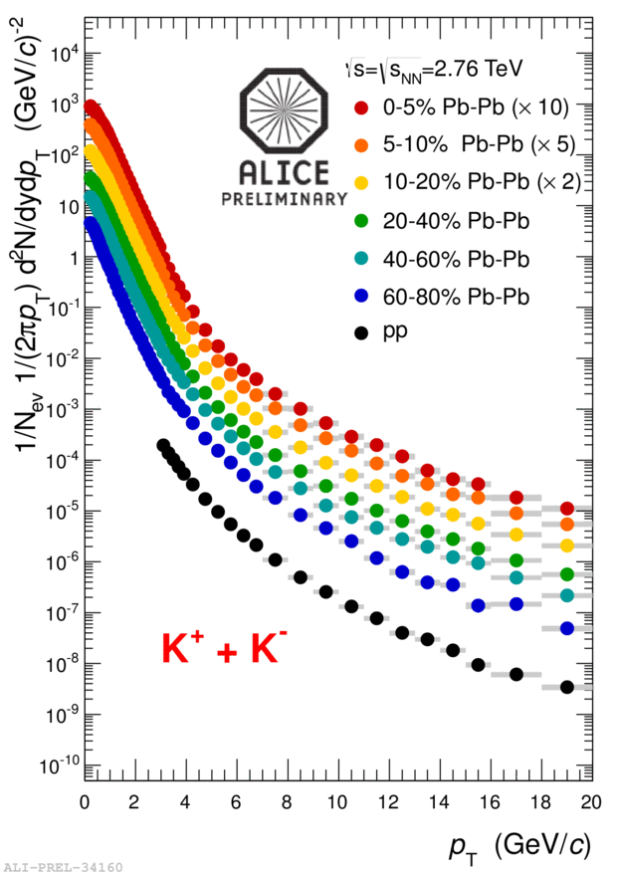
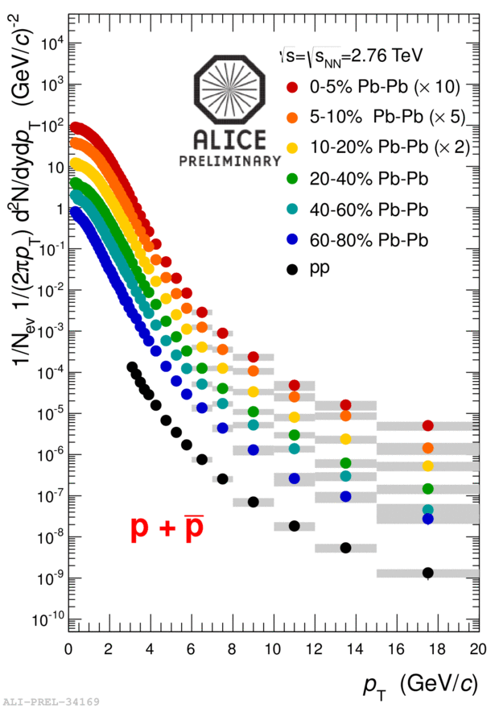
R_{AA} identified hadrons
Identified spectra from 2-3 < p_{T} < 20 GeV/c from Lund analysis. First time presented by Antonio Ortiz Velasquez (Lund) at Quark Matter 2012, August 12-18, Washington.
Extends ALICE unique PID capabilities to the hard regime

Slide 27
What is the medium formed in the collisions?
To talk about temperature we need to establish that a medium is formed e.g. collective effect = communication
Jet quenching still not well understood theoretically
  Need that to extract properties

Slide 28
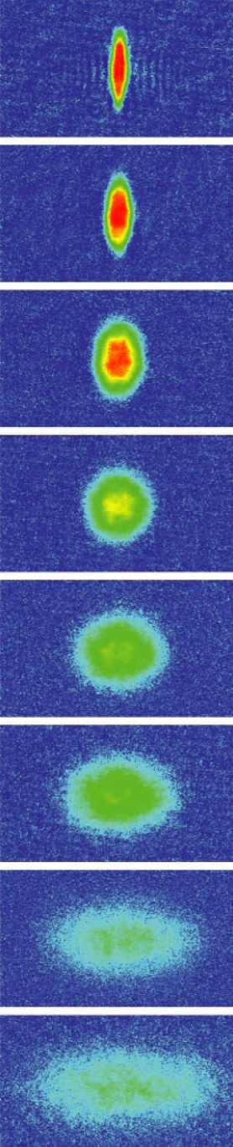
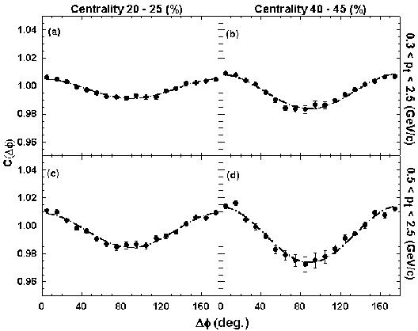
Elliptic flow (v2) unique in heavy ion collisions
Z
Fourier decomposition:
dN/dφ = 1 + 2 V₂cos(2 Δφ )
Y
X
Reaction plane
P_{y}
P_{z}
P_{x}
Initial
spatial
anisotropy
Strong
pressure
gradients
v₂
Azimuthal
anisotropy
Sensitivity to
early expansion

Slide 29
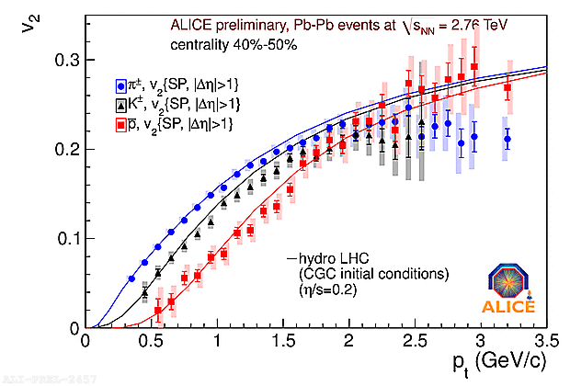
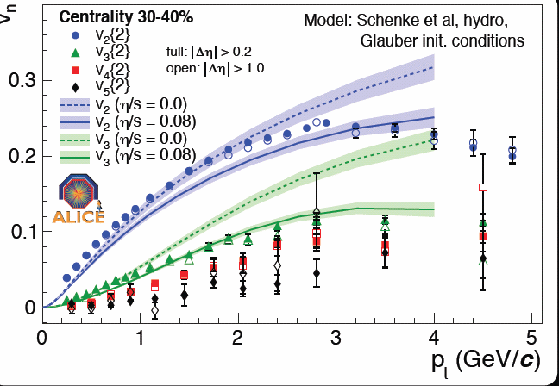
Elliptic flow and triangular flow is almost ideal
Huge flow at intermediate pT:
  2 times more particles in plane than out
  Nearly ideal fluid
Significant higher order flow caused by fluctuations – also described by nearly ideal hydro + initial state

Slide 30
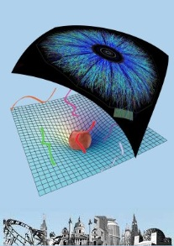
AdS-CFT
How to reconcile nearly ideal fluid with energy density like a relativistic gas?
AdS-CFT correspondence (conjecture)
  J.M. Maldacena, Adv.Theor.Math.Phys.2:231-252, 1998, 8595 citations on inspire=most cited
Duality between weakly coupled gravity like theory (AdS) and strongly coupled QCD like theory (CFT)
QCD like theory, but
  conformal (no confinement, no running coupling)
  infinite Ncolors
  SUSY
From:
http://quark.itp.tuwien.ac.at/~ads/

Slide 31
AdS-CFT
Two very important results:
  Conjectured bound on shear viscosity: η/s≥1/(4π)~0.08
    Viscosity in strongly interacting quantum field theories from black hole physics, P. Kovtun, D.T. Son, A.O. Starinets (Washington U., Seattle), Phys.Rev.Lett. 94 (2005) 111601. (989 citations on inspire.)
  Possibility of infinitely strong coupling at energy density of ¾ SB gas

Slide 32
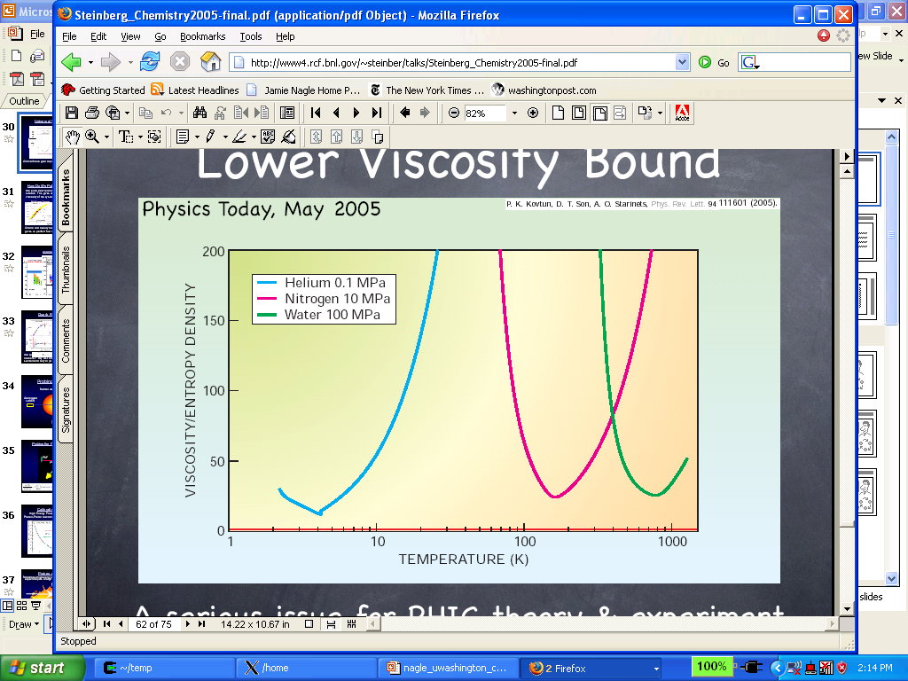
The QGP fluid compared to other fluids

Slide 33

The QGP fluid compared to other fluids
Strongly interacting Li atoms released from a trap
η/s ~ 7 x 1/4π
http://www.physics.ncsu.edu/jet/index.html

Slide 34

The QGP fluid compared to other fluids

Slide 35


The QGP is less like a crowd
and more like a synchro team
Big theoretical challenge:
  how to go from initial random collisions to organized state in a VERY short time (<1fm/c~10⁻²³s)
  Remains to be understood

Slide 36
How hot is the medium?

Slide 37



Temperature at freeze-out
Results from blast wave
analysis.
RHIC analysis from STAR
Nuclear Physics
A 757 (2005) .
Generate hadrons with weights: exp(-(m+μ_{B})/T)
Decay strongly
Compare to data

Slide 38


How to measure T at earlier times
Need a probe that does not freezeout at the end of the collision
  Direct photons (photons that are not from decays which is the major background)

Slide 39



Photon identification in the TPC via conversion
π⁰ → 2γ converts to 2*(e⁻ + e⁺) = background for signal

Slide 40



Direct photons in pp
Construct double ratio to elliminate/reduce systematics
Numerator is the actual measurement
Denominator is from a cocktail calculation

Slide 41

Direct photons in pp
Comparison to pQCD NLO calculation

Slide 42

Direct photons in peripheral Pb-Pb
Peripheral Pb-Pb
  Consistent with only direct and decay photons

Slide 43

Direct photons in central Pb-Pb
Central Pb-Pb
  p_{T} < 2 GeV/c: ~20% excess of direct photons
  p_{T} > 4 GeV/c: agreement with N_{coll}-scaled NLO

Slide 44


Direct photon spectrum in central Pb-Pb
Obtain spectrum by scaling

Slide 45

Direct photon spectrum in central Pb-Pb with fit
Exponential fit for p_{T} < 2.2 GeV/c
  inv. slope T = 304±51 MeV for 0–40% Pb–Pb at √s=2.76 TeV
  PHENIX: T = 221±19±19 MeV for 0–20% Au–Au at √s=200 GeV

Slide 46



Heavy quark thermometer
Note: 6.5<p_{T}<30 GeV for J/ψ and ψ(2s)
Observation of sequential suppression of Y (b+b-bar) family
Expected in terms of binding energy
Unfortunately heavy quark results are more complex when systematically studied!

Slide 47
Summary
In heavy ion collisions at ultra-relativistic energies the hadronic matter melts forming a hot (T>200 MeV) nearly perfect quark-gluon fluid
The description of this fluid is governed almost entirely by ideal hydrodynamics and it seems it is insensitive to specific constants (light quark masses)
Even the viscosity seems to be common for QCD like theories
This new state of matter thus seems to be a very fundamental property of QCD (as apposed to nuclear and atomic matter which is very sensitive to SM constants)

Slide 48

Probing the early universe
+ animation
QGP – the phase of the universe 1 micro second after
What is the impact on the evolution of the early universe of a perfect liquid phase?

Slide 49
Backup

Slide 50

Identified particle ratios:
T and μ_{B} at freezeout
Generate hadrons with weights: exp(-(m+μ_{B})/T)
Decay strongly
Compare to data
Particle ratios are well described by statistical models when decay from hadronic resonances are taken into account (only QCD input are the masses and decays)
The temperature is consistent with what we expect from Lattice QCD calculations for the transition temperature

Slide 51


The QCD phase diagram with the measured T and μ_{B}
T_{lim} = 161 ± 4 MeV
A. Andronic,
P. Braun-Munzinger,
J. Stachel,
nucl-th/0511071
Because of the simple beam-energy systematics statistical models have predictive power!
The statistical description of particle rations is also good for lower energies: AGS and SPS
The temperature saturates at T~160 MeV indicating that the system has crossed the phase boundary
But p+p ratios can be described with a similar (canonical) formalism and T! So it is a hadronization attribute.

Slide 52





The nuclear modification factor for pions
$$R_{AA}=\frac{d^{2}{N^{AA}}/dp_{T}dy}{〈N_{bin}〉d^{2}{N^{NN}}/dp_{T}dy}$$

Slide 53


The nuclear modification factor for direct photons
Source of direct photons
Direct photons does not interact with final state hadronic matter!
At low pT photons are dominantly decay photons e.g. π⁰→2γ
Direct photons confirm binary scaling of hard processes!

Slide 54



Disappearance of the away side jet indicates final state effect
Side view
Most jets are created
back to back!
Beam view
Trigger
Associated
particles
Pedestal&flow subtracted
Away side suppression
4 < p_{T}(trig) < 6 GeV/c
p_{T}(assoc) > 2 GeV/c

Slide 55
Disappearance of the away side jet indicates final state effect
Side view
Most jets are created
back to back!
Beam view
Trigger
Associated
particles
Pedestal&flow subtracted
Away side suppression
4 < p_{T}(trig) < 6 GeV/c
p_{T}(assoc) > 2 GeV/c

Slide 56


Au+Au vs d+Au
Hot vs cold nuclear matter
All 4 experiments published
together in PRL:
d+Au
Au+Au
No suppression seen in d+Au
→Final state effect not seen at lower energy!
Quarks and gluons loose/radiate energy as they propagate through the dense medium!
They probe the created matter

Slide 57

Could the binary scaling be wrong?
Source of direct photons
Direct photons does not interact with final state hadronic matter!
Direct photons shows no nuclear modification and therefore confirm binary scaling of hard processes!

Slide 58


New “standard candle” at LHC: ATLAS measures Z bosons
The Z does not interact strongly and so can also be used to check binary scaling at LHC

Slide 59


Elliptic and triangular flow for identified particles at high p_{T}
PID using TPC: dE/dx - <dE/dx>_{π}
4.5 < p_{T} < 5.0 GeV/c
PID using “clean” regions of dE/dx on the relativistic rise
arXiv:
1205.5761

Slide 60
Elliptic and triangular flow for identified particles at high p_{T}
The v₂ and v₃ also peaks in the intermediate p_{T} region
  Large particle species dependence
End of hydrodynamic flow for p_{T} ≥ 9-10 GeV/c ?
  Triangular flow which is not sensitive to collision geometry becomes small
  No or small particle species dependence for v₂ (little mass dependence)
  And pion v₂ is well described by jet quenching prediction

Slide 61


Peripheral Event
From real-time Level 3 display.
color code ⇒ energy loss
STAR

Slide 62


Mid-Central Event
From real-time Level 3 display.
STAR

Slide 63


Central Event
From real-time Level 3 display.
STAR

