Slide 1
Accelerator Cryogenics
An Introduction
J. G. Weisend II
Deputy Head of Accelerator Projects
Adjunct Professor, Lund University
November 14, 2014

Slide 2
Outline
Introduction
Production of Cold
Refrigerators & liquefiers
Carnot efficiency
Coefficient of performance
Maintenance of Cold
Cryostats and cryomodules
Basic heat transfer mechanisms and guidelines for design
Example cryostat (ESS Elliptical cavity CM)
Summary

Slide 3
Introduction
Cryogenics : the science and technology of phenomena occurring below 120 K
Cryogenics plays a major role in modern particle accelerators
Enables superconductivity
Beam bending and focusing magnets (1.8 K – 4.5 K)
Magnets for particle identification in large detectors (4.2 – 4.5 K)
Superconducting RF cavities for particle acceleration (1.8 K – 4.2 K)
Allows dense pure liquids
LAr calorimeters (87 K)
LH₂ moderators, targets and absorbers (20 K)

Slide 4
Introduction
Since the Tevatron (1983) accelerator cryogenic systems have become larger, more reliable, more efficient, industrialized and much more widespread
Cryogenics is found in all types of accelerator applications including: HEP accelerators, light sources, heavy ion machines, neutron sources and ADS
This lecture will give an overview including examples of several key aspects of cryogenic engineering related to accelerators. But there is much more to learn.
I will discuss how we get equipment to cryogenic temperatures and keep it at those temperatures in accelerators.

Slide 5
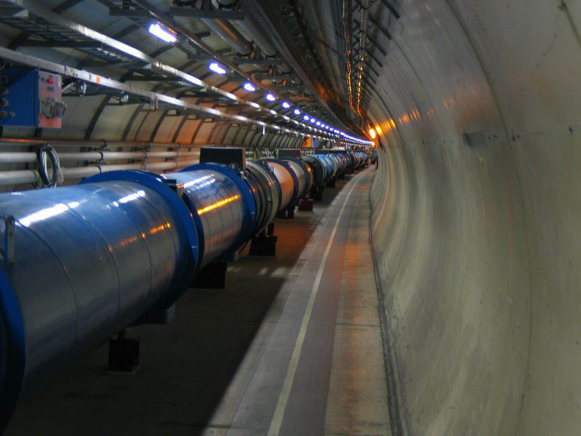
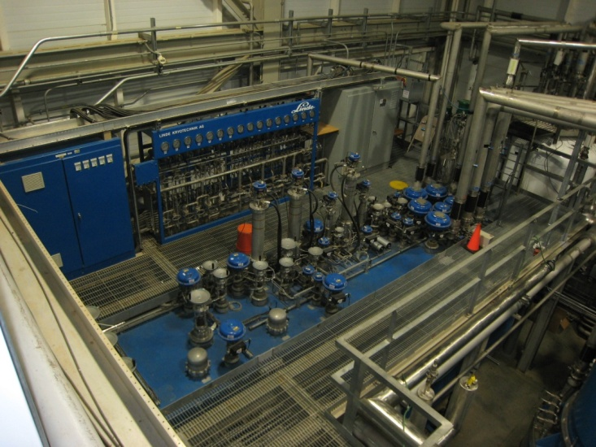
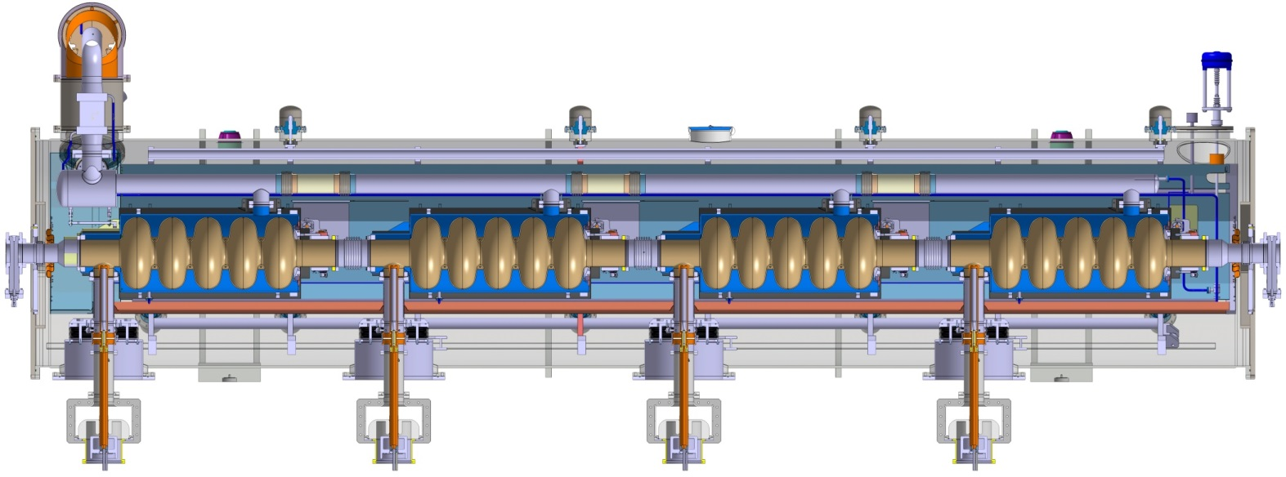
Introduction
SNS
4 K
Cold
Box
LHC
Magnets
ESS Cryomodule

Slide 6
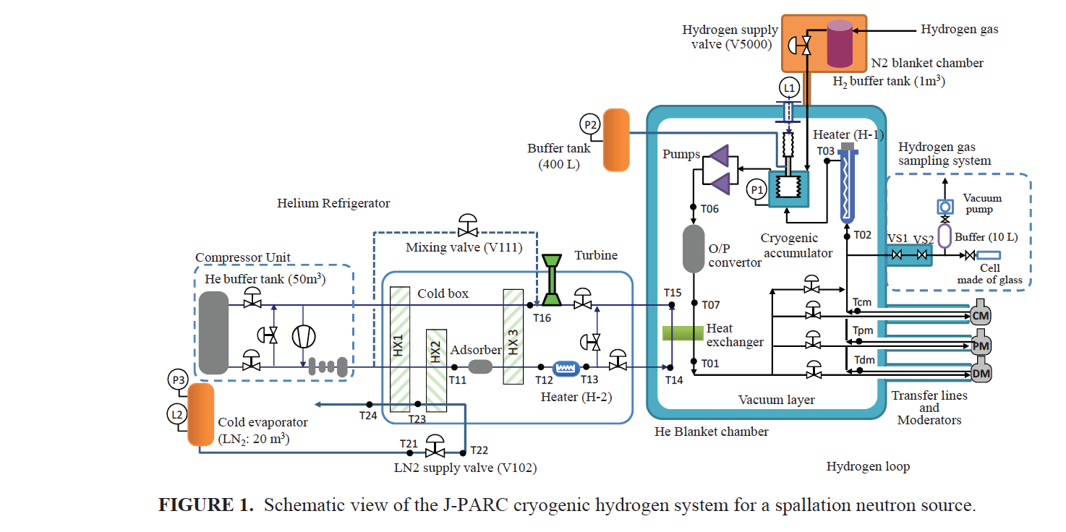
Introduction
JSNS LH₂ Moderator (6.5 kW @ 16 K)
ATLAS
Magnets
At CERN

Slide 7
Catching Cold
There are really only a few ways in which to make a pure fluid such as helium colder
Cause the fluid to do work by making it expand against a piston or turbine while keeping it thermally isolated from the outside environment Isentropic Expansion
Transfer heat from the fluid to a colder surface
Cause the fluid to do “internal work” by expanding it through a valve while keeping it thermally isolated Isenthalpic Expansion or Joule-Thomson expansion
Once the fluid is a liquid, reduce the pressure above the fluid below atmospheric pressure thus reducing the saturation temperature
All modern cryogenic plants do the first 3. Ones that provide cooling below 4.2 K also do the last item

Slide 8
Collins Cycle
Cycle consists of :
1) Compression of Helium to ~ 16 Bar with cooling back to 300 K + oil removal
2) Cooling of high pressure gas with LN₂
3) Isentropic expansion via 2 or more expansion engines
4) Cooling of high pressure gas by the cold returning low pressure stream
5) Isenthalpic expansion through JT valve
6) Return of gas to compressors at just above 1 Bar

Slide 9
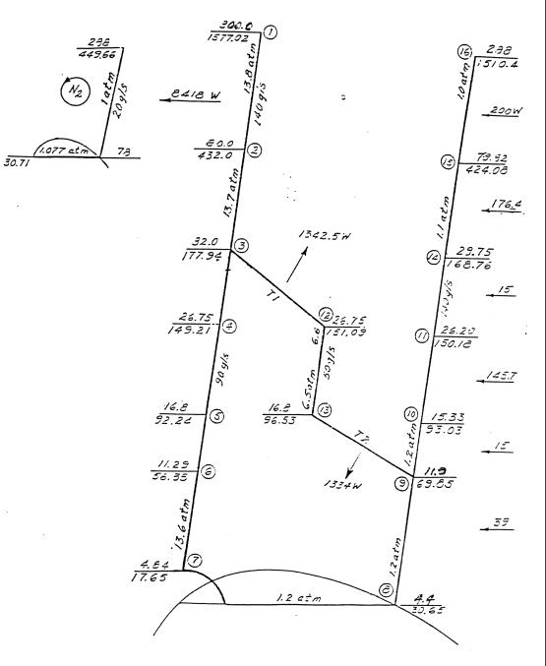
CTI 4000 Refrigerator (early 80’s vintage ~ 1.2 kW @ 4.5 K)

Slide 10
LHC 4.5 K Refrigeration Plant 18 kW @ 4.5 K – produced in ~ 2004 1of 8 required (4 from Linde, 4 from Air Liquide)
Note:
Large number of expansion turbines – some in series with HP stream
Medium pressure return
Heat loads at intermediate temperatures

Slide 11
Carnot Cycle
This is an ideal cycle: all processes are reversible
Entropy is only changed by absorbing or removing heat at constant temperature
2nd law of Thermodynamics, in a reversible process dQ = -TdS
The Carnot Consists of 4 steps
Compress the working fluid isothermally at T_{H} (1-2)
Expand the working fluid isentropically from T_{H} to T_{C} (2-3)
Absorb heat into the working fluid isothermally and reversibly at T_{C} (3-4)
Compress the working fluid isentropically from T_{C} to T_{H} (4-1)
Note isentropically = reversibly and adiabatically

Slide 12
Carnot Cycle
T_{H}
2
1
T_{C}
3
4
Q
S
s₁
s₂
How do we describe the performance of such a cycle?

Slide 13
Coefficient of Performance & the Carnot Cycle
Coefficient of Performance: the heat absorbed from the cold sink divided by the net work required to remove this heat
Minus sign takes into account that the heat absorbed by the cycle is positive while the work done is negative
Since this is a closed cycle, the net work done is equal to the net heat transferred. Since this cycle completely reversible, the 2nd law gives the net heat transferred as:

Slide 14
Coefficient of Performance & the Carnot Cycle
Thus
Again from the 2nd Law:
Thus, for the Carnot cycle the COP may be written as:
For the Carnot cycle the COP is dependent only on the temperatures

Slide 15
Coefficient of Performance & the Carnot Cycle
For a plant operating between room 300 K and 4.2 K, the Carnot COP is 4.2/( 300 – 4.2) or 0.0142
The Carnot cycle is the ideal case. It is the best you can do without violating the laws of thermodynamics
Note that the form of the Carnot COP shows that you have a better COP (thus a more efficient process or refrigerator) if T_{C} is large
It is always thermodynamically more efficient to intercept heat (provide cooling) at higher temperatures
This fact drives a lot of cryogenic design
In practice, we generally discuss the inverse of the COP because this allows us to describe the number of watts of work required to provide 1 Watt of cooling at a given temperature. For a Carnot cycle providing cooling at 4.2 K. This is 70 W/W
People will frequently and incorrectly refer to this as a COP as well

Slide 16
Carnot Cycles & the Real World
Can we build a real machine using a Carnot cycle? In a word NO
Why?
Compressing a fluid isothermally is very hard to achieve, Normally the fluid is compressed and then cooled back down to 300 K
Expanding or compressing fluid isentropically is basically impossible
We can absorb heat into a boiling fluid isothermally but not with out irreversible losses
How close can we get to Carnot? We define the Figure of Merit (FOM) as:
We also speak in terms of “percent Carnot” i.e. FOM of 0.2 is 20% Carnot

Slide 17
The real world is sometimes not kind to cryogenic engineers
These are state of the art helium refrigerators. Note that the best of them (for LHC) runs at about 220 W/W or a FOM of 0.318 or at 32% Carnot

Slide 18
ESS Cryoplant Energy Recovery
25C
Middle temperature Return
37C
27C
Middle temperature Supply
He to fine oil removal
25C
Compr. motor
39C
83C
High temperature Return
32C
27C
Middle temperature Return
He from cold box
90C
85C
Helium compressor
Helium cooler
Oil vessel
90C
85C
32C
27C
Oil
cooler

Slide 19
Cryostats, Cryomodules and Dewars
What is a cryostat?
A device or system for maintaining objects at cryogenic temperatures.
Cryostats that contain SCRF cavity systems are also frequently called cryomodules
Cryostats whose principal function is to store cryogenic fluids are frequently called Dewars. Named after the inventor of the vacuum flask and the first person to liquefy hydrogen

Slide 20
Cryostats
Cryostats are one of the technical building blocks of cryogenics
Cryostat design involves many subtopics most of which we don’t have time to cover here:
Development of requirements
Materials selection
Thermal insulation
Support systems
Safety
Instrumentation
One of the best ways to learn about cryostat design is through examples
There are many different types of cryostats with differing requirements
The basic principles of cryostat design remain the same
Before we can do anything else we have to define our requirements

Slide 21
E158 LH₂ Target Cryostat

Slide 22
Cryostat Requirements
Maximum allowable heat leak at various temperature levels
This may be driven by the number of cryostats to be built as well as by the impact of large dynamic heat loads (SCRF or target cryostats)
Alignment and vibration requirements
Impact of thermal cycles
Need to adjust alignment when cold or under vacuum?
Alignment tolerances can be quite tight (TESLA :
+/- 0.5 mm for cavities and +/- 0.3 mm for SC magnets)
Number of feed throughs for power, instrumentation, cryogenic fluid flows, external manipulators

Slide 23
Cryostat Requirements
Safety requirements (relief valves/burst discs)
Design safety in from the start. Not as an add on
Size and weight
Particularly important in space systems
Instrumentation required
Difference between prototype and mass production
Ease of access to cryostat components
Existing code requirements (e.g. TUV or ASME)
Need, if any, for optical windows
Presence of ionizing radiation

Slide 24
Cryostat Requirements
Expected cryostat life time
Will this be a one of a kind device or something to be mass produced?
Schedule and Cost
This should be considered from the beginning
All Design is Compromise

Slide 25
Thermal Insulation
This is key to proper cryostat design
The effort and cost expended on this problem are driven by cryostat requirements:
Dynamic vs. static heat loads
Number of cryostats
Operational lifetime & ability to refill cryostats (e.g. space systems)
Lowest possible static heat leak isn’t always the best answer
It is thermodynamically best to intercept heat leaks at the warmest temperature practical

Slide 26
Three Ways to Transfer Heat
Conduction
Heat transfer through solid material
Convection
Heat transfer via a moving fluid
Natural or free convection – motion caused by gravity (i.e. density changes)
Forced – motion caused by external force such as a pump
Radiation
Heat transferred by electromagnetic radiation/photons
There is no such thing as a perfect insulator – though we can design systems with very small heat leaks
All matter above 0 K radiate heat

Slide 27
Conduction Heat Transfer
Fundamental Equation – The Fourier Law in one dimension
If we assume constant cross section we get:
Reduce conduction heat leak by:
Low conductivity material: make K(T) small
Reduce cross sectional area: make A small
Increase length: make L large
For a given T_{C} make T_{H} smaller: i.e. use intermediate temperature heat intercepts

Slide 28
Design Example ILC Cryomodule Support Post
Courtesy T. Nicol - Fermilab
300 K
300 K
Fiberglass pipe
70 K
80 K
G-10 Tube
4 K
5 K
2 K
2 K
Total Heat Leak (conduction & radiation)
70 K - 10.5 W
5 K - 0.9 W
2 K - 0.03 W
Can support up to 50 kN

Slide 29
Convection Heat Transfer
Fundamental Equation: Newton’s law of cooling
Q = hA(T_{surface} – T_{fluid})
where h is the heat transfer coefficient and is a function of Re, Pr, geometry etc depending on the situation
In cryogenics we eliminate convection heat leak in cryogenic systems by “simply” eliminating the fluid – vacuum insulation
Using vacuum insulation to create vessels capable of storing cryogenic liquids was first done by James Dewar – who liquefied hydrogen

Slide 30
Vacuum Insulation
How much vacuum is enough?
This of course depends on the heat leak requirements but generally we want to be below 10⁻⁵ mBar If we maintain this level or better we can generally neglect the convection heat leak for most applications.
Cryopumping
At cryogenic temperatures almost all common gases condense and freeze onto the cold surface. Typically, we’ll see that once surface are cooled to ~ 77 K the isolation vacuum will drop to the 10⁻⁸ mBar or better range if the system is leak tight and doesn’t have significant outgassing

Slide 31
Radiation Heat Transfer
Frequently the largest source of heat leak to cryogenic systems
Fundamental Equation: Stefan-Boltzmann Law – energy emitted from an ideal black body: E_{b} = σT⁴ where σ = 5.67x10⁻⁸ W/m²K⁴
Real world Assumptions:
Emissivity (ε) << 1 and independent of wavelength (grey body)
Two parallel infinite plates: Radiative heat flux (W/m²)
Eq. A
Frequently in cryogenic systems ε₁ ~ ε₂ << 1 then Eq. A becomes:
Eq. B

Slide 32
Radiation Heat Transfer
Two long concentric cylinders or concentric spheres (1 represents the inner cylinder): the radiative heat flux (W/m²) on the inner cylinder is
Eq. C
Note as is frequently the case in cryogenics, if the spacing between the cylinders is small compared to the inner radius (i.e. A₁ ~ A₂ ) Eq. C becomes Eq. A

Slide 33
Radiation Heat Transfer
Looking at Eq. A, How do we reduce the radiation heat transfer?
We could reduce the emissivity (ε)
This is done in some cases; using either reflective tape or silver plating
Better below 77 K
It’s also part of MLI systems (see below)
We have to consider tarnishing
May be labor intensive
From Helium Cryogenics – S. W. Van Sciver

Slide 34
Radiation Heat Transfer
Another way to reduce radiation heat transfer is to install intermediate actively cooled radiation shields that operate at a temperature between 300 K and the lowest cryogenic temperature. This has several advantages.
It greatly reduces the heat load to the lowest temperature level
Assume parallel plates with ε = 0.2
then from Eq. B q ( 300 K – 4.2 K ) = 46 W/m² while q (77 – 4.2) = 0.2 W/m²
It allows heat interception at higher temperatures & thus better Carnot efficiency
Such an actively cooled shield provides a convenient heat intercept for supports, wires etc to reduce conduction heat leak.
Shields may be cooled by
Liquid baths ( LN₂)
Vapor boil off from stored liquid – common in LHe storage dewars
Cooling flows from refrigeration plants
Conductive cooling via small cryocoolers

Slide 35
Radiation Heat Transfer
Use Multilayer Insulation (MLI) or “superinsulation” inside the vacuum space to reduce heat leak

Slide 36
Multilayer Insulation
Used in almost all cryostats
Consists of highly reflective thin sheets with poor thermal contact between sheets
Don’t pack MLI too tightly. Optimal value is ~ 20 layers / inch
Great care must be taken with seams, penetrations and ends.
Problems with these can dominate the heat leak

Slide 37
Example of MLI in LHC Magnets
“SERIES-PRODUCED HELIUM II CRYOSTATS FOR THE LHC MAGNETS: TECHNICAL CHOICES, INDUSTRIALISATION, COSTS” A. Poncet and V. Parma Adv. Cryo. Engr. Vol 53

Slide 38
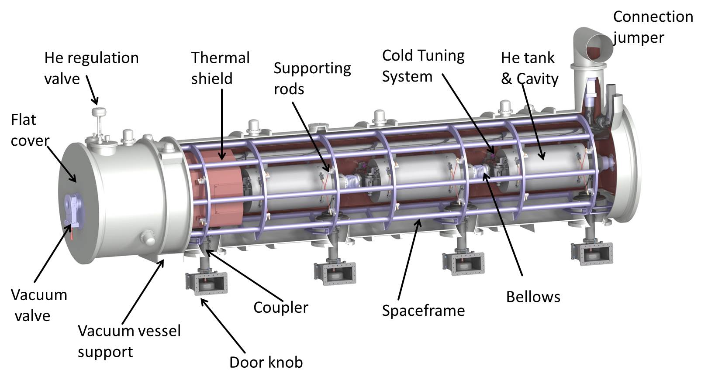
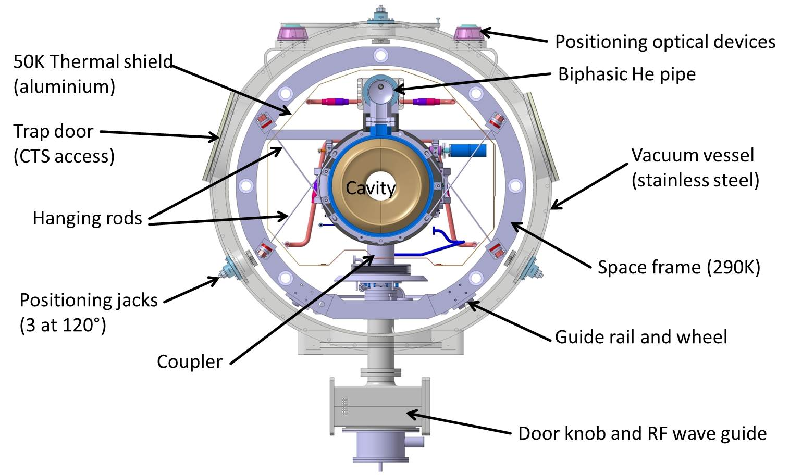
How Are These Principles Used on
the ESS Elliptical Cryomodule Design ?
Similar to CEBAF/SNS cryomodule with 4 cavities per cryomodule
Common design for medium (6 cells) and high beta (5 cells) cavity cryomodules
Courtesy P. Bosland CEA
Accelerating gradient:
for β=0.67 (Medium Beta): Eacc=16.7 MV/m Qo> 5E9 at 2 K
for β=0.86 (High Beta): Eacc=19.9 MV/m Qo> 5E9 at 2 K
Maximum operating helium pressure: 1.431 bar
total length: 6.6 m
Beam height: 1.5 m

Slide 39
There is Much More to Cryogenic Engineering
This has been just a small sample of cryogenic engineering as applied to accelerators. Other topics include:
Properties of Cryogenic Fluids
Cryogenic Properties of Materials
He II (superfluid helium)
Safety in Cryogenics
Instrumentation
Cryogenic Distribution Systems
Cryogenics below 1 K
Use of Small Cryocoolers
Vacuum Systems
High Temperature Superconductor Applications
Superconducting Magnets and RF Cavities

Slide 40
The Use of Cryogenics in Accelerators is Growing
More than 17 current accelerators use cryogenics in some form and an additional 15 new accelerators using cryogenics are planned between now and 2025 in a wide range of locations: Europe, India, China, Korea, Brazil, USA, Japan
These future accelerators include some very large installations: FAIR, XFEL, ESS, LCLS II, ILC
The need for trained staff in this area is an issue and Lund University is in the early stages of developing a center of excellence in cryogenics including classes (senior undergraduate/graduate), research projects and collaborations with ESS and possibly Maxlab

Slide 41
Examples of Operating Facilities
Name | Type | Lab | T (K) | Refrigeration Capacity | Comments
LHC | Accelerator CMS ATLAS | CERN | 1.9 4.5 4.5 40/80 80 | 8 plants ea 2.4kW @ 1.9K 1.5 kW @4.5 K 6 kW @ 4.5K 20 kW @ 40 – 80 K 20 kW @ 80 K | Each plant has 18 kW capacity eqv. @ 4.5 K LAr calorimeter
CEBAF/12 GeV | Accelerator | JLab | 2.1 | 8.4 kW @ 2.1 K
JSNS | H₂ Moderator | J-PARC | < 20 | 6.5 kW @ 15.6 K
SNS | Accelerator H₂ Moderator | ORNL | 2.1 20 | 2.4 kW @ 2.1 K 7.5 kW @ ~ 20 K
S-DALINAC | Accelerator | TU Darmstadt | 2.0 | 120 W @ 2.0 K
FLASH | Accelerator | DESY | 2.0 |  | TESLA tech
RHIC | Accelerator | BNL | 4 | 24.8 kW @3.8 K plus 55 kW @55K
ARIEL (e linac) | Accelerator | TRIUMF | 2.0 | 288 L/h

Slide 42
Examples of Future Facilities
Name | Type | Lab | T (K) | Refrigeration Capacity | Status (Start of Operation)
ESS | Accelerator LH2 moderator Instrum. supply | ESS | 2.0 40/50 16 4.2 | 3 kW 11 kW 25 kW 7500 l/month | Construction (2019)
ERL | Electron Linac | Cornell | 1.8 5 40-50 | 7.5 kW @ 1.8 K 6.8 kW @ 5 K 144 kW @ 40-80 | Proposed: Prototypes under construction TESLA Tech
XFEL | Electron Linac | DESY | 2.0 5 – 8 40-80 | 2.5 kW @ 2 K 4 kW@ 5 -8 K 26 kW @ 40-80 K | Construction (2017) TESLA Tech
LCLS II | Accelerator | SLAC | 2.1 K | ~ 4 kW @ 2.1 K | Construction (2019) TESLA Tech
FAIR | Accelerator & separator magnets | FAIR/GSI | 4 50-80 | Up to 37 kW@ 4 K Up 30 kW @ 50- 80 K | 2 Plants Construction ( 2019)

Slide 43
Summary
Cryogenics is an enabling technology in modern particle accelerators
Cryogenics is a multidisciplinary field using many aspects of physics and engineering
The use of cryogenics in accelerators (as well as in other scientific research fields) is growing and additional talent is needed.
ESS and Lund University are working together to develop a center of excellence in cryogenics in Lund

Slide 44
Back Up Slides

Slide 45
Refrigerators vs. Liquefiers
Refrigerators are closed cycle systems
They provide cooling and can create liquids but all the mass flow is returned to the start of the cycle
Such systems are said to have “balanced flow”
Liquefiers are open cycle systems
They provide a liquid which is then drawn off and used elsewhere
These have “unbalanced flows” the amount of mass returned to the start of the cycle is less than the amount that started by the mass that was converted to liquid.
In order to keep the cycle running this mass would have to be added as room temperature gas.

Slide 46
Refrigerators vs. Liquefiers
In practice, this distinction is less clear cut
Modern cryogenic plants can operate either as refrigerators or liquefiers and in fact, generally operate as a mixture of the two.
We talk about refrigeration loads & liquefaction loads
A key issue is at what temperature is the boil off gas from a cryogenic liquid returned to the cycle?
If brought back at a cryogenic temperature and used to cool incoming warmer gas then this is a refrigeration load
If brought back warm and not used to cool incoming warmer gas this is a liquefaction load
The thermodynamic rules are the same for refrigerators and liquefiers

