Slide 1
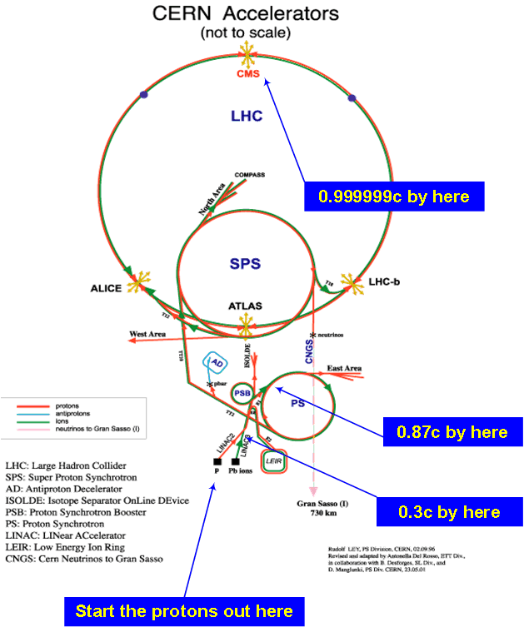
CERN, accel
Internal target

Slide 2
Reconstructed event Pb+Pb
High p in lab system
Focused forward
in space
Very long exp. setup
Not economical
since much energy
needed to conserve
parallel momentum
Colliding beams
instead

Slide 3
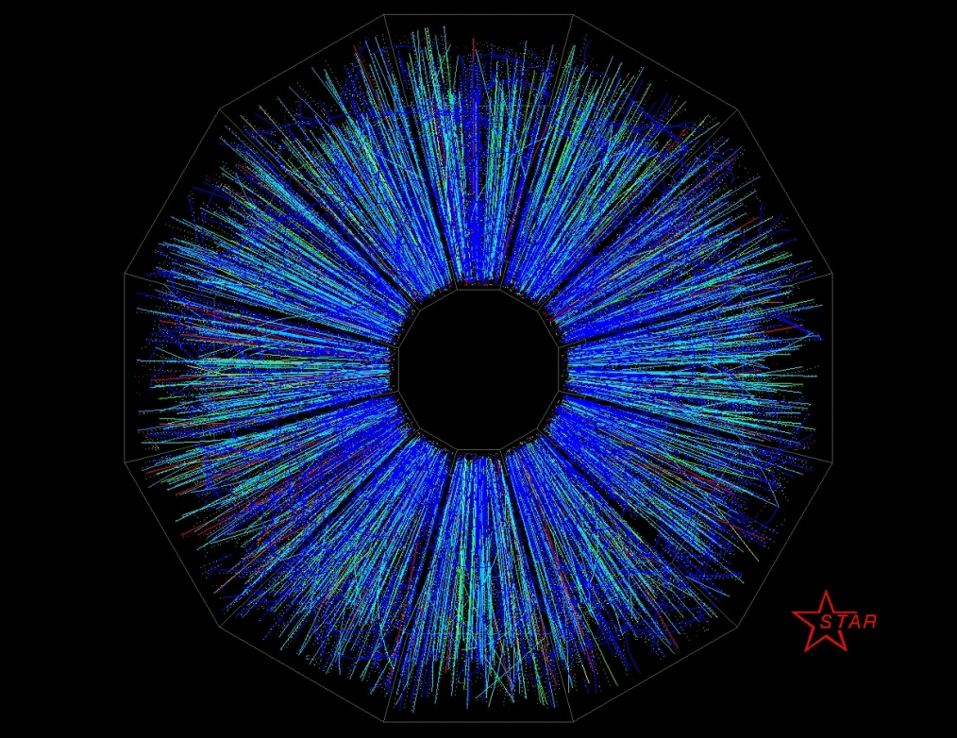
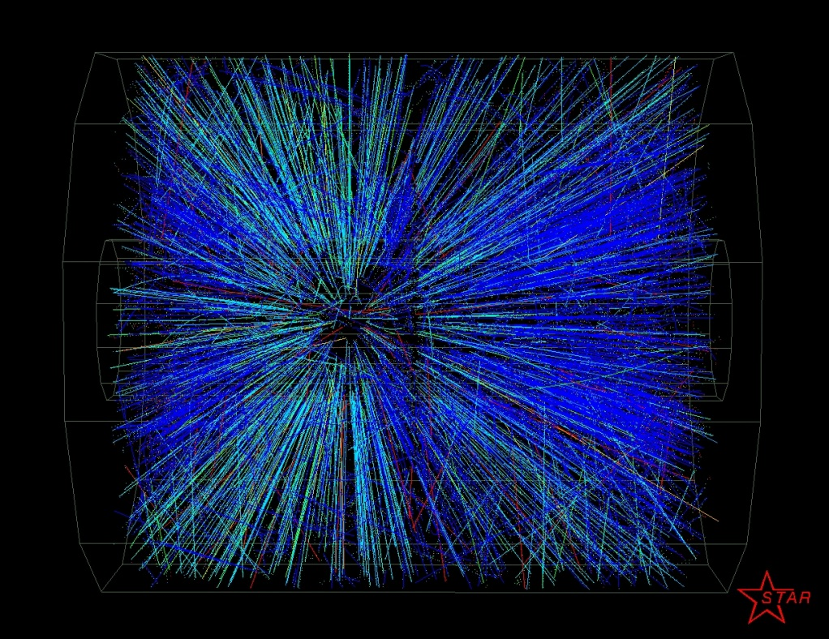
Au+Au at 30+30AGeV, colliding beams @RHIC
What’s the difference compared to stationary target?

Slide 4
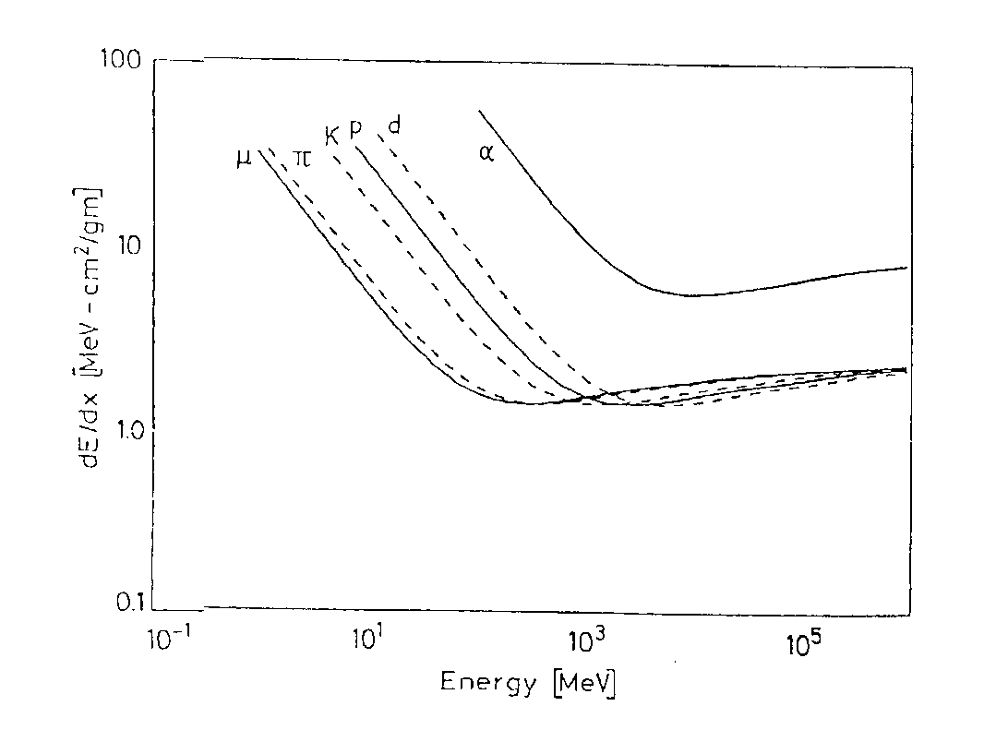
Charged particles
Particle identification
ΔE/Δx
m/E_{k}
m²/p²
Make a thin detector followed by a thick one (thick enough to stop the particle:
ΔE/Δx
E_{k}

Slide 5
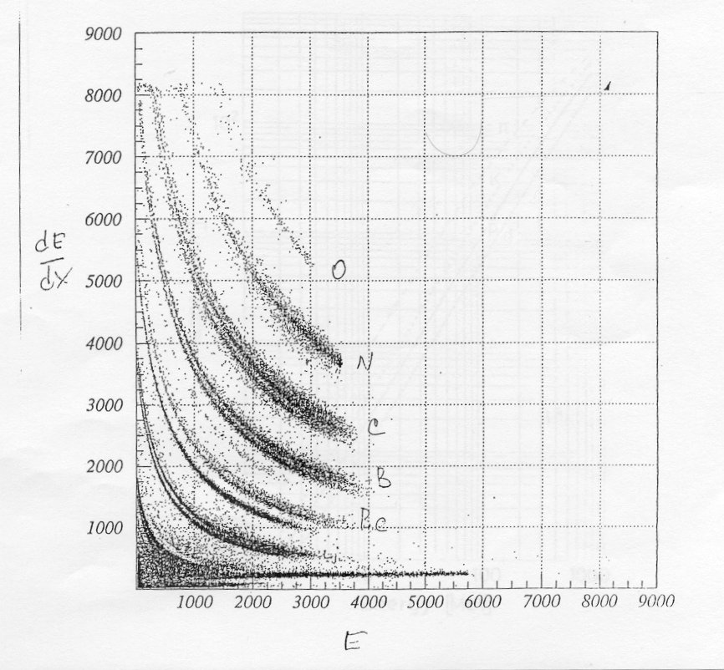
dE/dx
E
charged
part

Slide 6
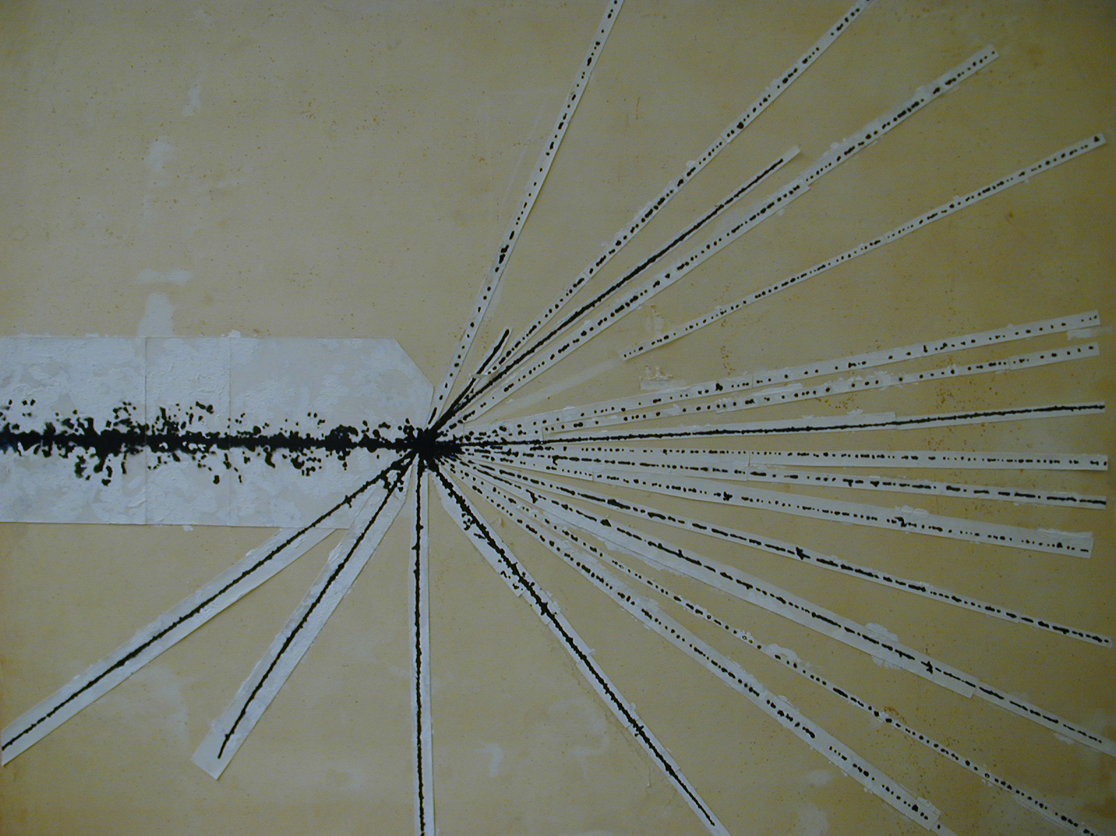
⁴⁰Ar at ca 100AMeV
z²
δ
stop?
Notes:
Inkommande Z^2: Ar 18^2 mer an protoner… joniserar kraftigt
Delta-elektroner nagra um ut (I gas nagon mm ut)
Stop partikel
He-4 tappar energi
Notera att detta ar en projektion…

Slide 7
Particle physics, measuring high energy particles

Slide 8

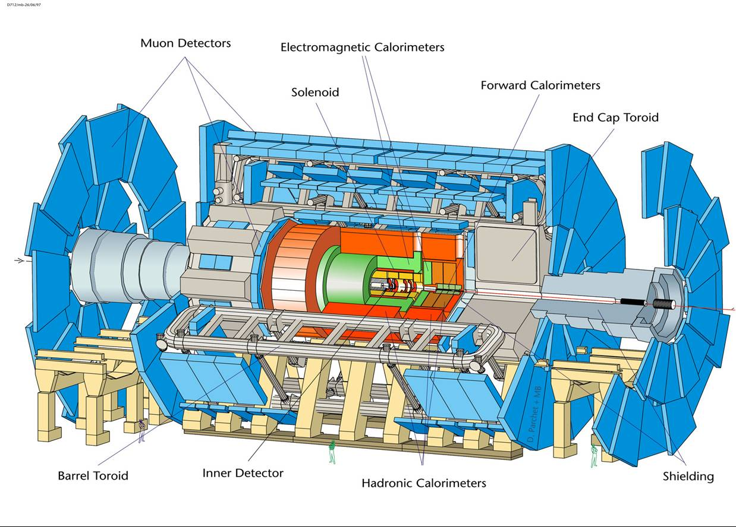
The ATLAS Experiment
Can not be put in vacuum... Have to make corrections instead.
Use GEANT simulations
Notes:
OK. Somewhat larger scale…

Slide 9
Charged particles
ΔE/Δx
m/E_{k}
m²/p²
Measure p and dE/dx (or v) if the particle energy is too high to stop
the particles

Slide 10
How to measure momentum
mv² =RqvB
mvq⁻¹ =RB
Normally q=e
so
p=mv=eRB
B known, R measured
=> p determined
stop
R
B
v
start

Slide 11
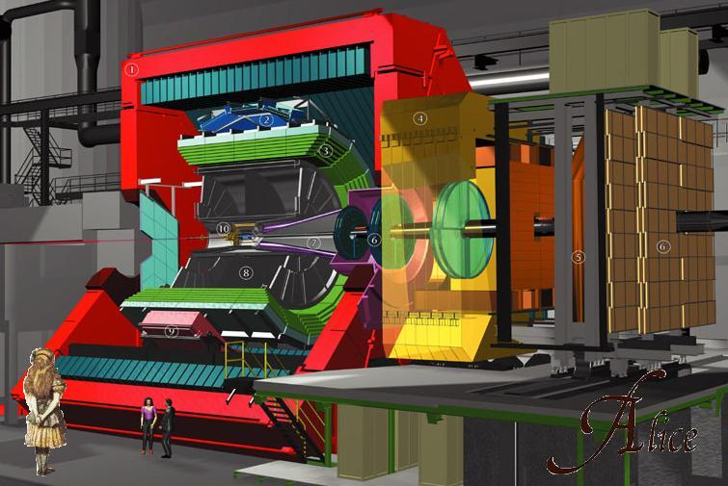

Slide 12
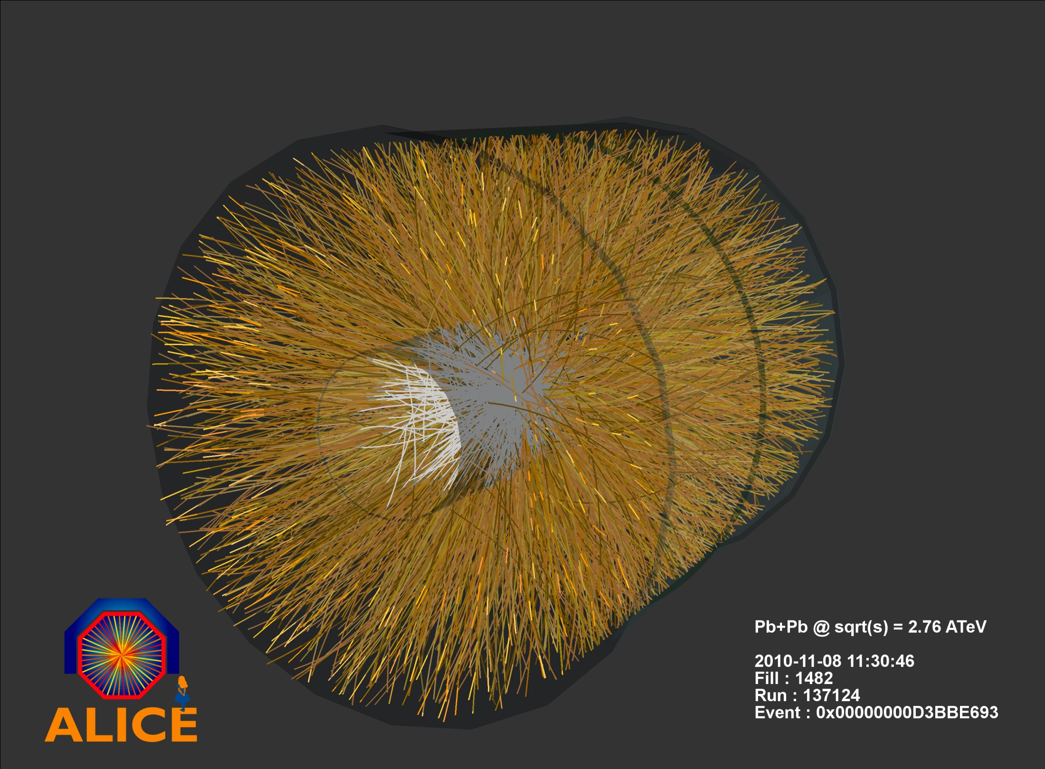

Slide 13
Paricle identification, dE/dx vs momentum from ALICE TPC

Slide 14
Measure velocity instead of dE/dx
mv² =RqvB
mvq⁻¹ =RB
Normalt q=e
så
p=mv=eRB
p determined as before
Measure v
Calculate m
=> Particle identified.
stop
R
B
v
start
v=FlightLength/(t_{stop} – t_{start})=L/TOF

Slide 15
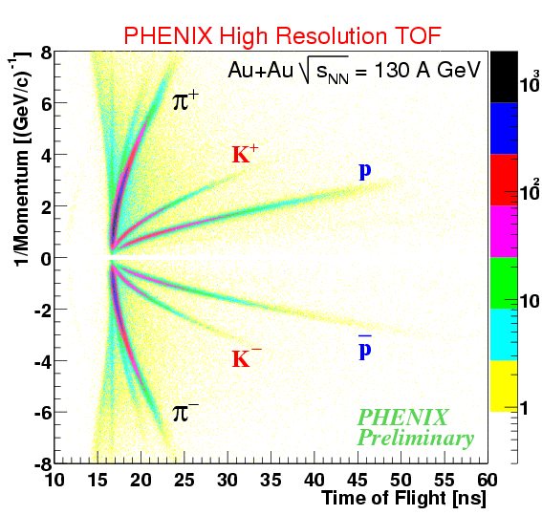
μ⁺
e+
e-
μ⁻
Only these particles are long lived enough to reach a detector

Slide 16
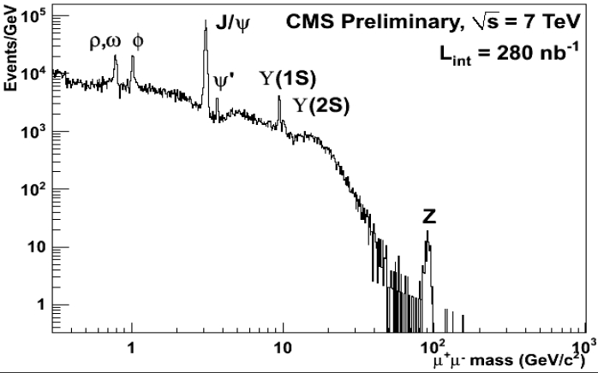
All others must be detected via their decay products

Slide 17
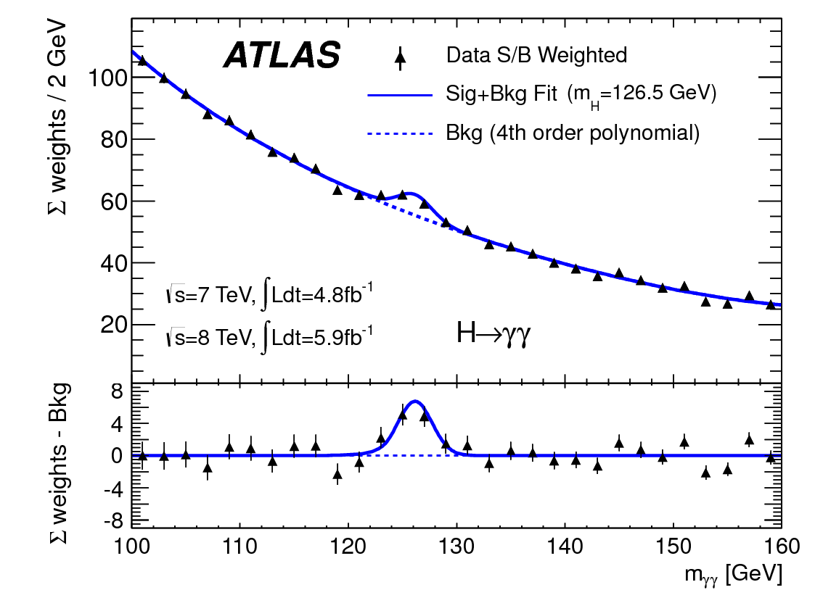
Higgs partikel

